Slide 1
Day 4 - Sunday
December 4, 2011

Slide 2
Vista Hermosa Ward, 3a Calle “A” 24-59 Zona 15 Colonia El Refugio with Arturo Mijangos.
Bill Southwick chubasco@willitsonline.com, 2369 6492 (high school Spanish teacher)
Clete Mask (She is a Garns and served 63-65, he served 61-63)
Rolando Amado conducted.
Eric/Sonia/Cesar Soto
Antonio Lepe Montufar
Drlepe1954@yahoo.com
9 Calle A Jardines de San Cristobal 9-34 Sector A 10
San Cristobal Sector II
Casa 39
4393 1595
Julia De Lepe (esposa)
Ma Jose Lepe Queveda
Antonio Lepe Quevedo
Laura Lepe Quevedo
Barrio 8 capilla to see children of Julio Rene Valle Vallejo
Julio Adan Valle CPA (mother and sister live in Toronto, CA)
juliova@yahoo.com
Mercedes Valle
Mvalle0306@hotmail.com
Raul Ureta – seguros
reureta@gmail.com
Estela Parra-abogada (Arturo’s sister?)
Barrio 5 to see if any one left. Met son-in-law of Julio. Also met Sara Cassiano de Molina who would have been there when I was there.
Lunch with the Mijangos family.
Took Tobler’s trunk to Susan’s (husband works at embassy – from Billings, Montana – works with government bank re:money laundering.
Christmas devotional with the senior missionaries.

Slide 3
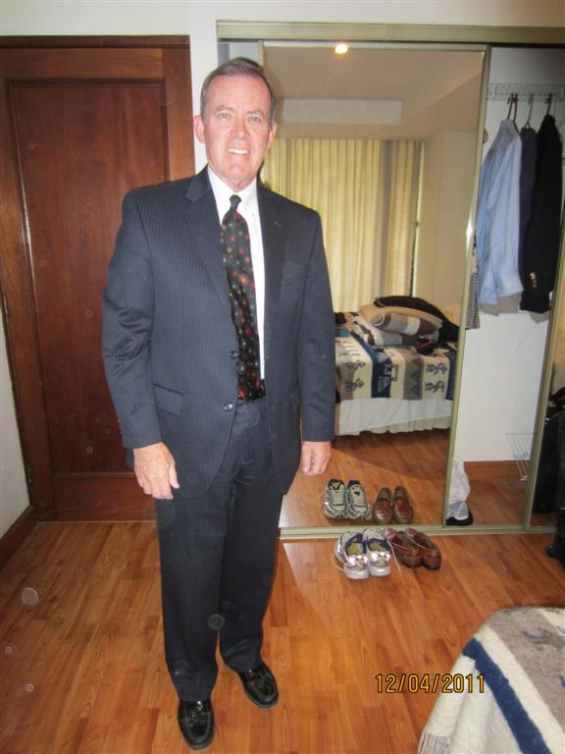

Slide 4
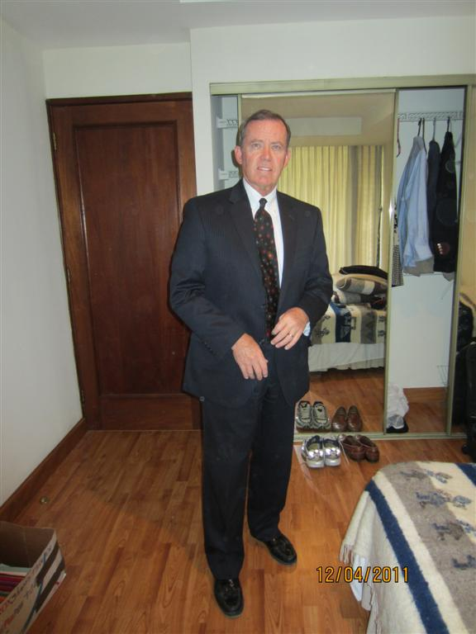

Slide 5
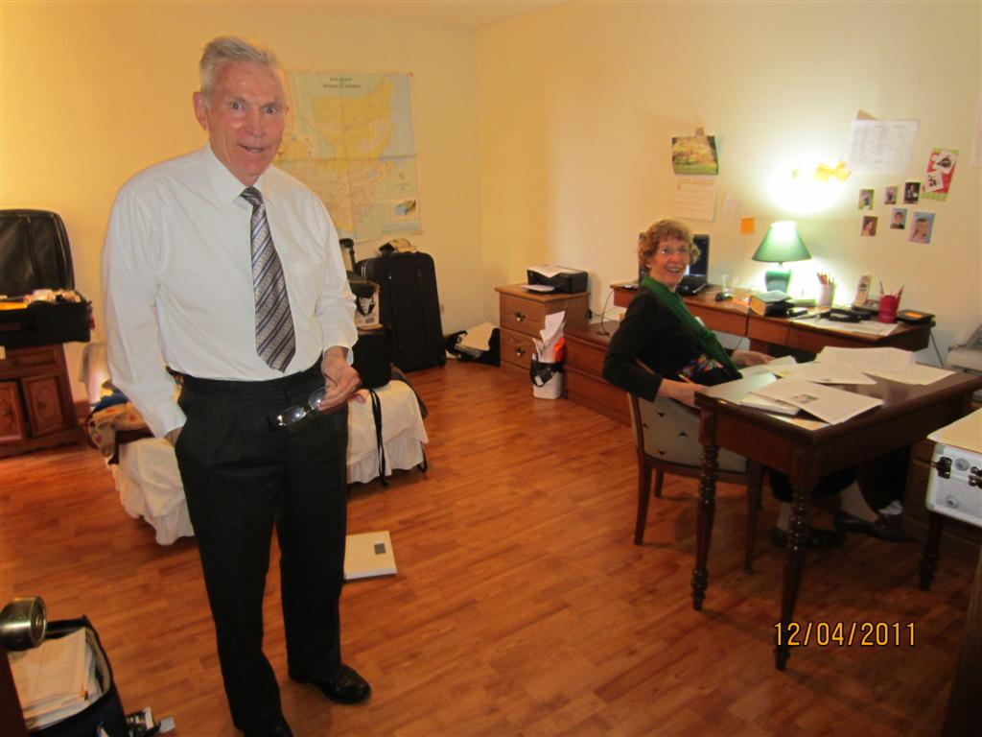

Slide 6
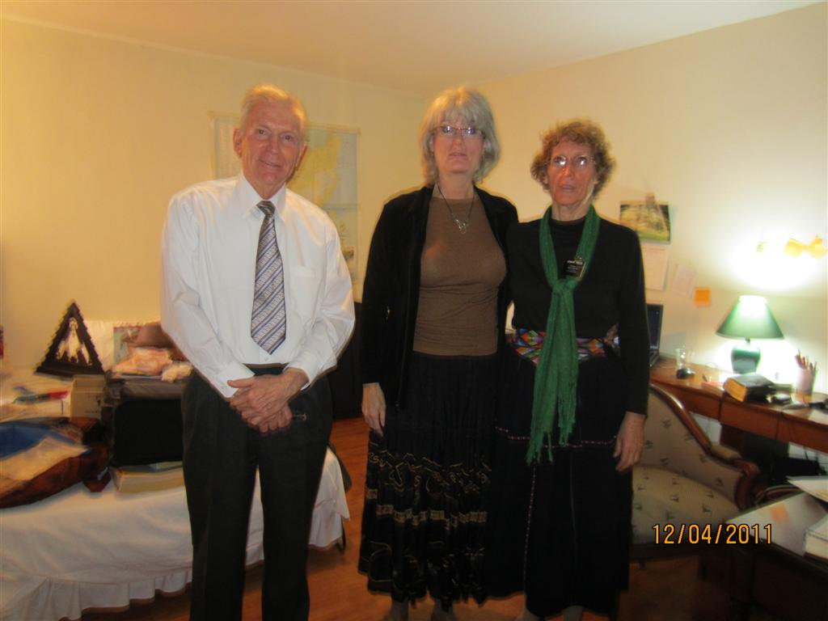

Slide 7
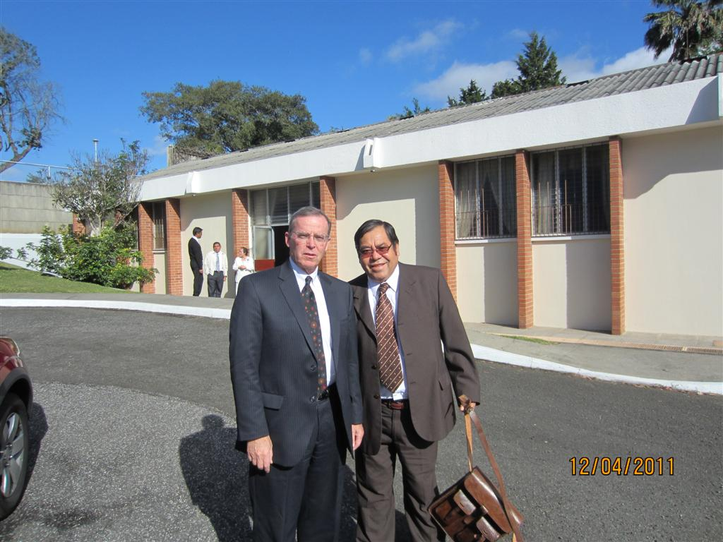

Slide 8
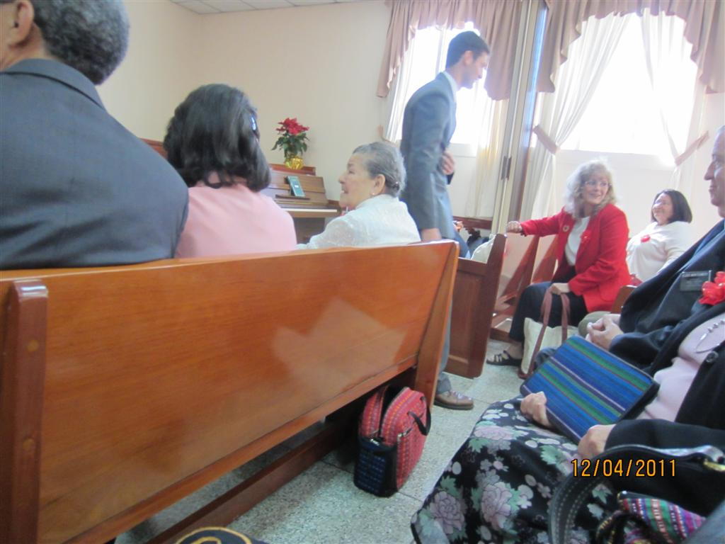

Slide 9
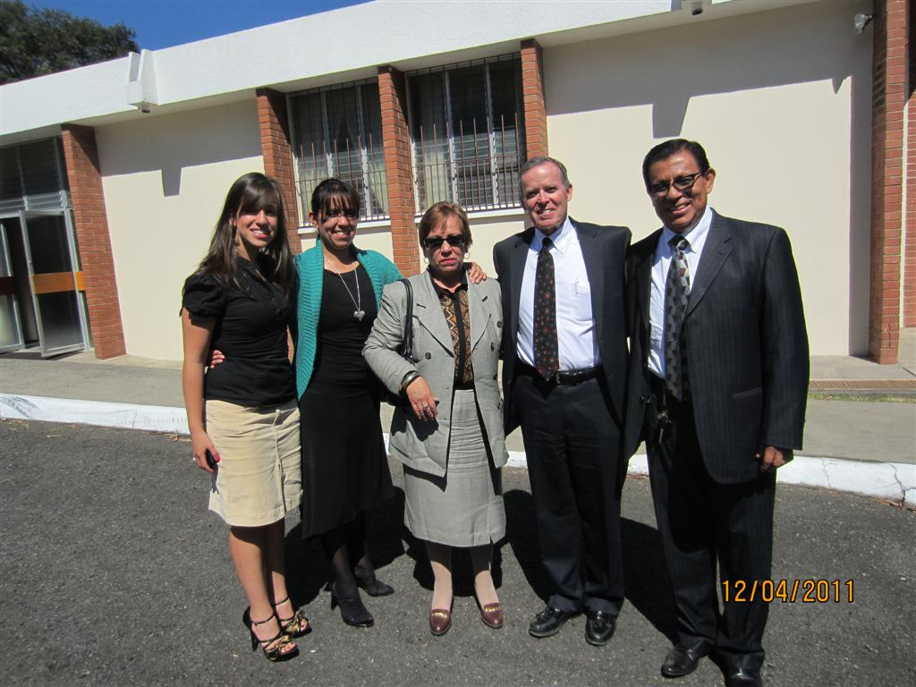

Slide 10
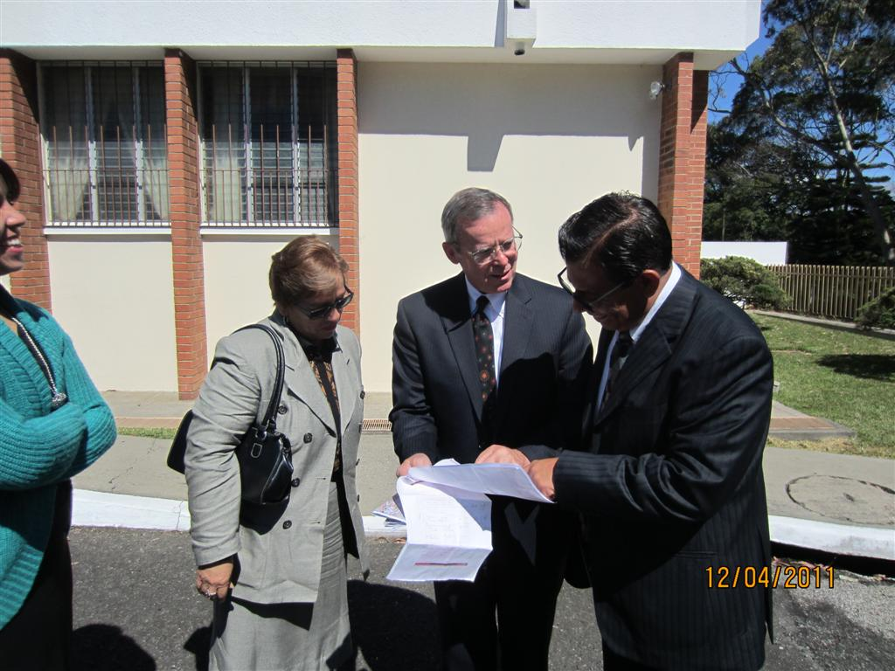

Slide 11
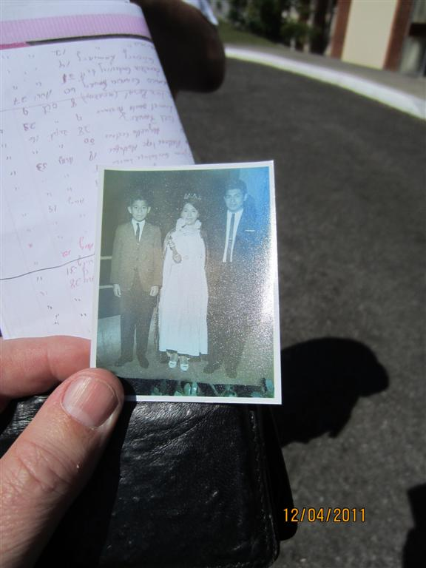

Slide 12
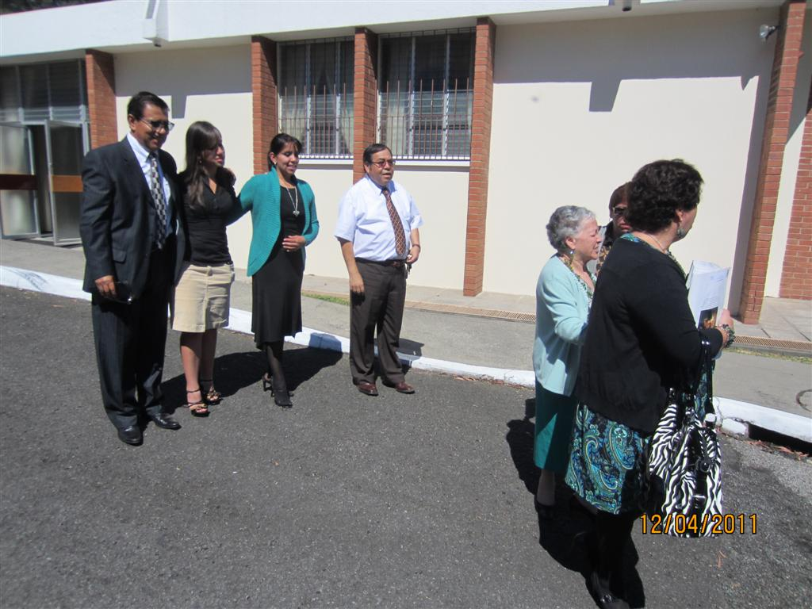

Slide 13
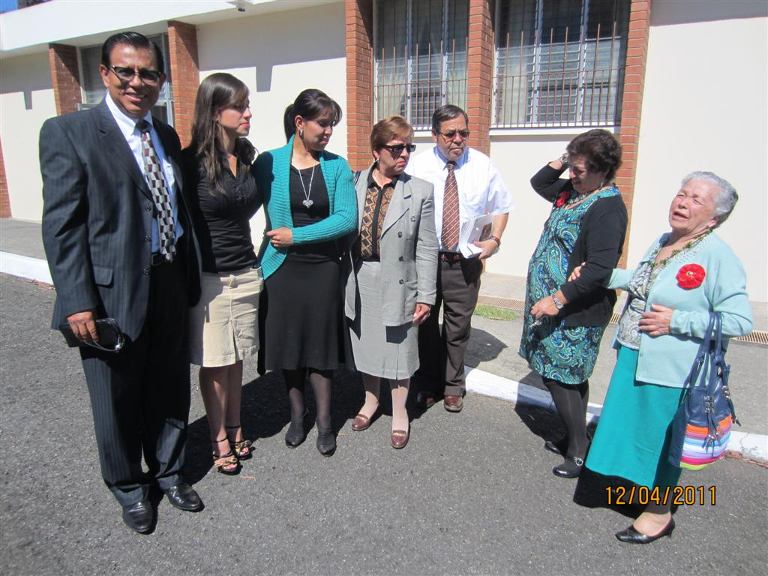

Slide 14
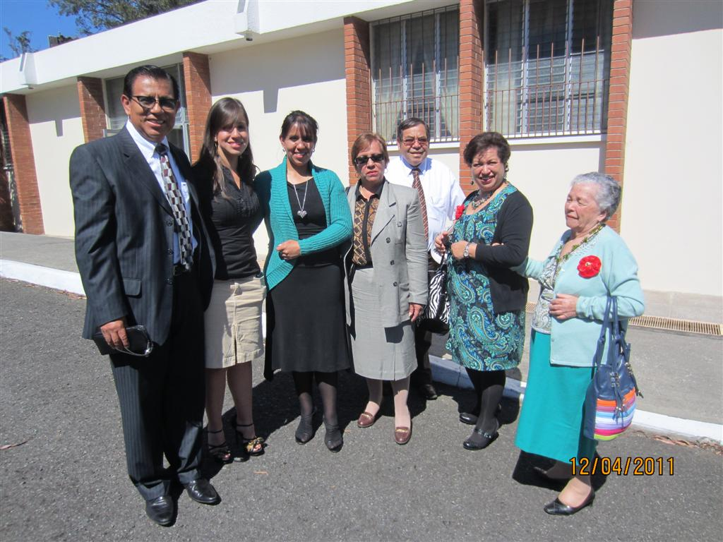

Slide 15
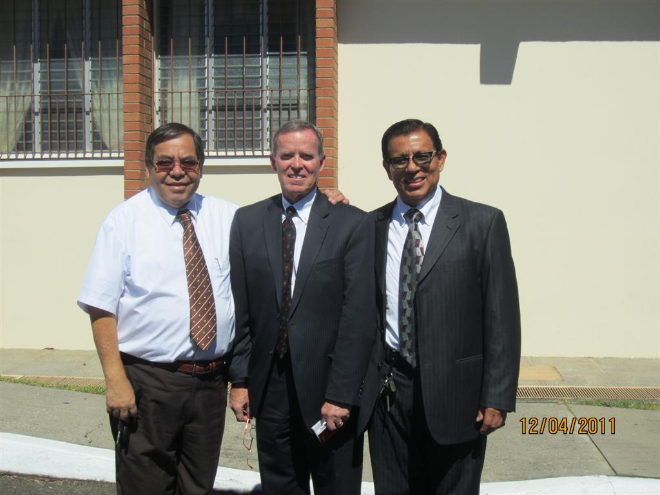

Slide 16
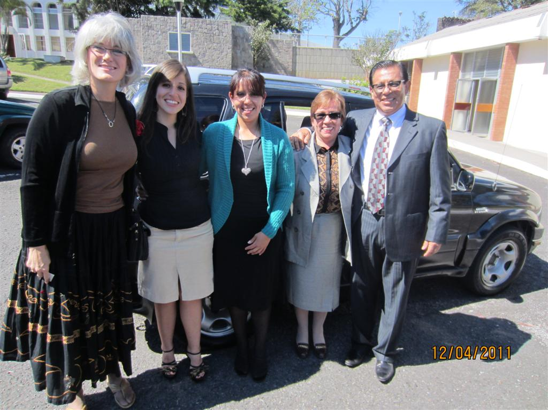

Slide 17
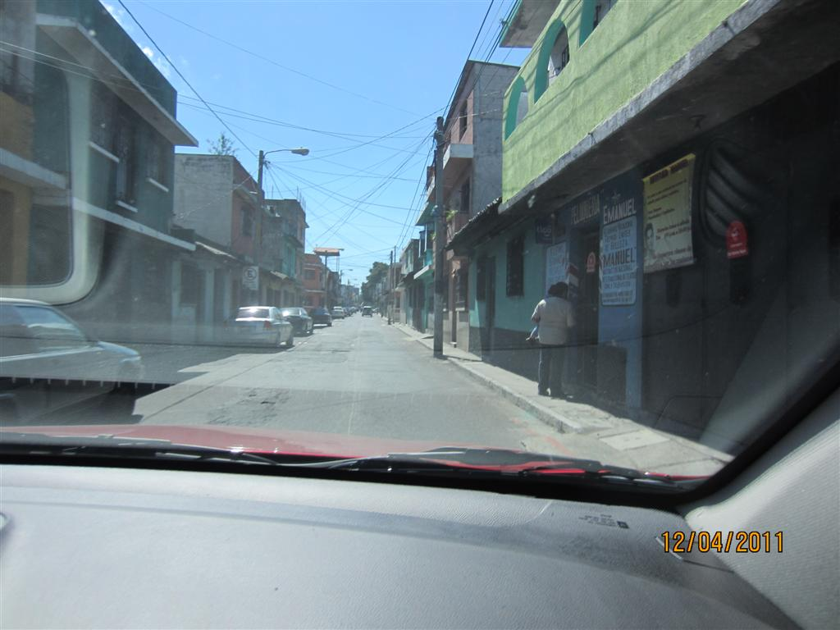

Slide 18
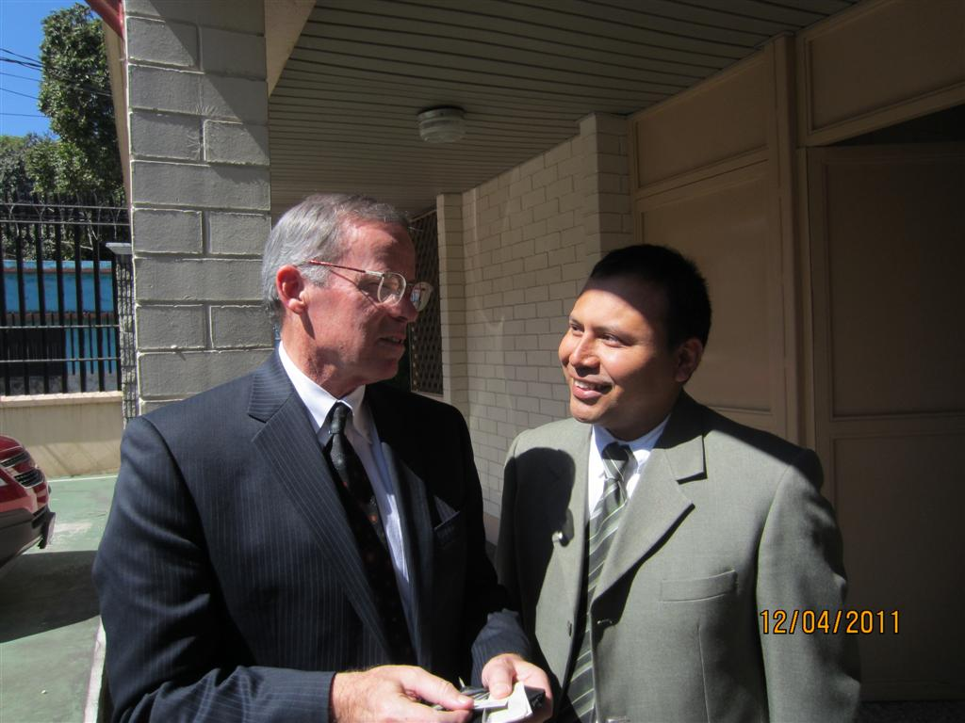

Slide 19
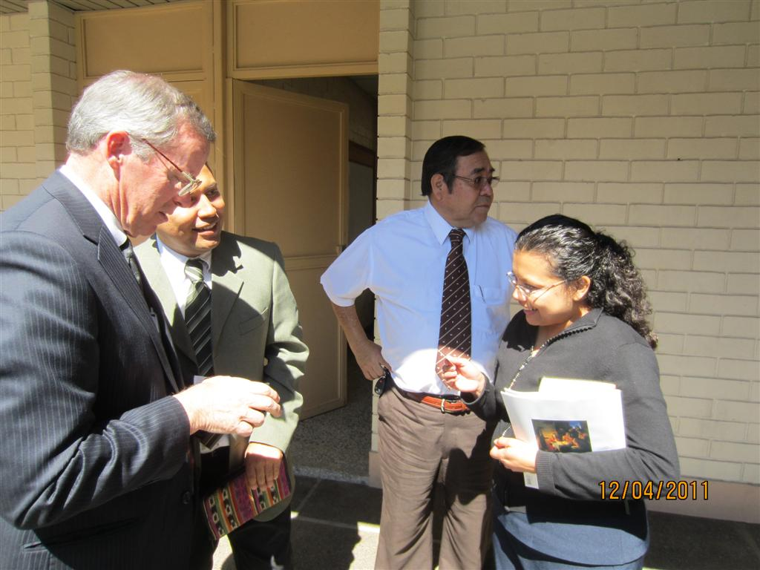

Slide 20
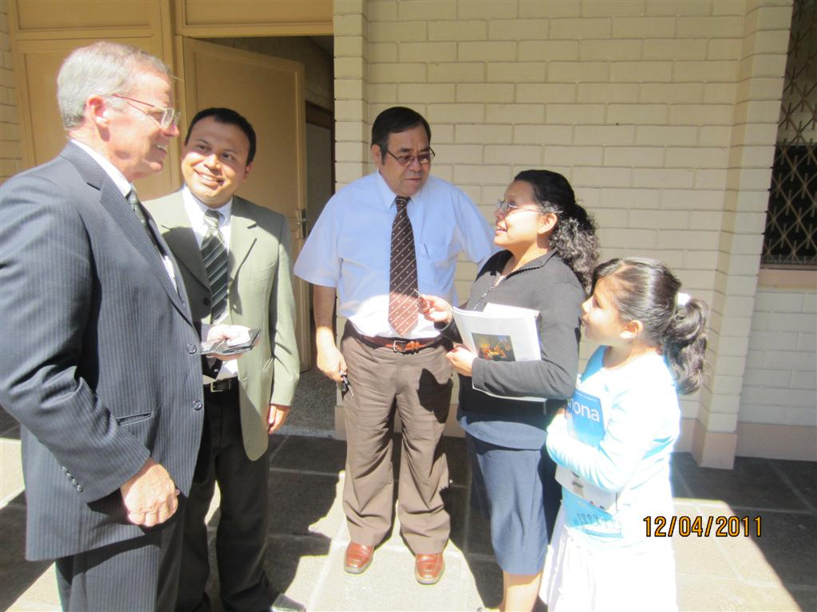

Slide 21
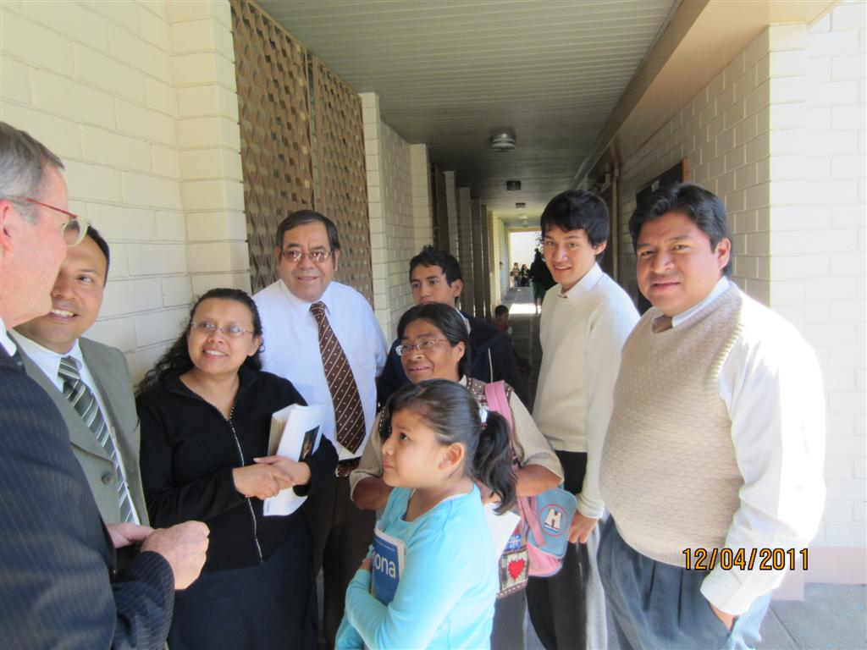

Slide 22
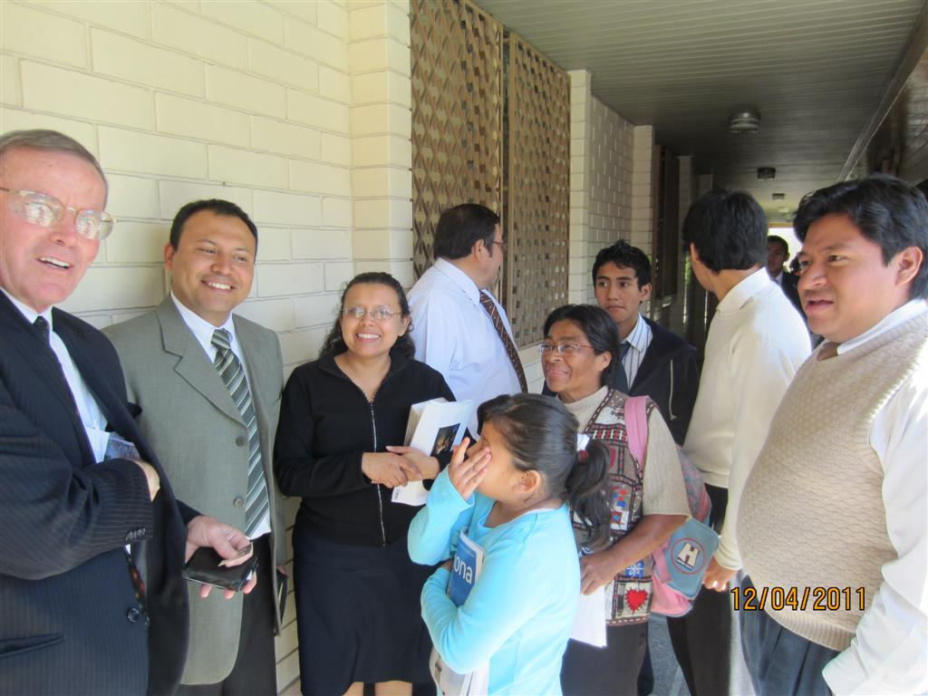

Slide 23
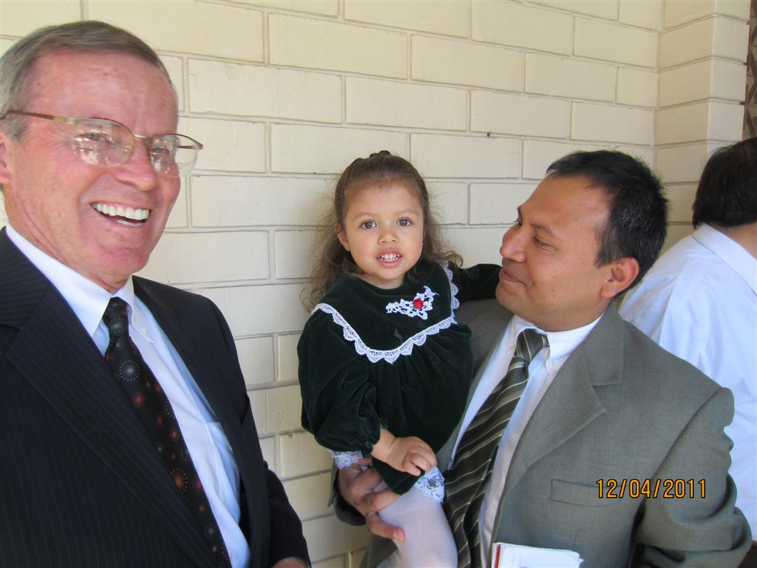

Slide 24
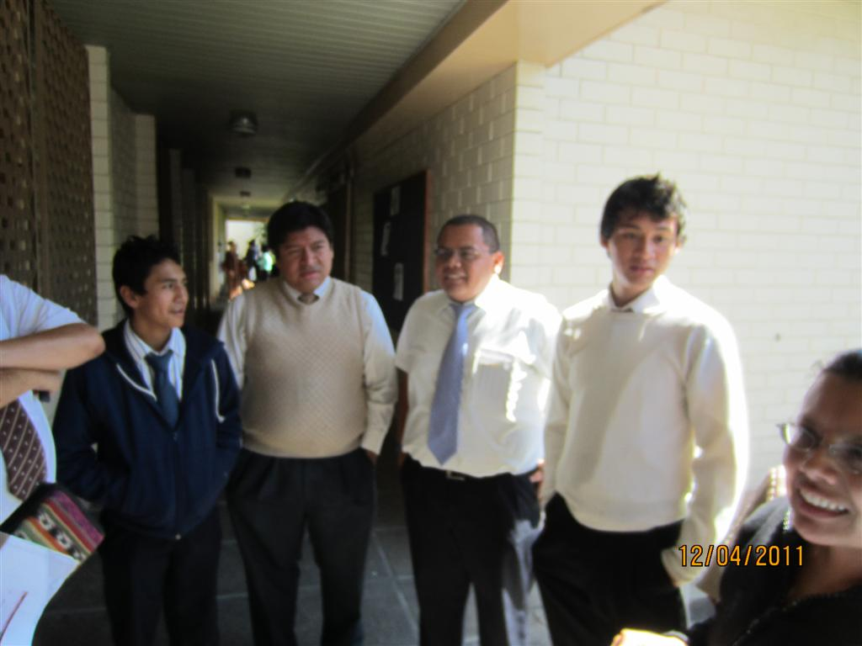

Slide 25
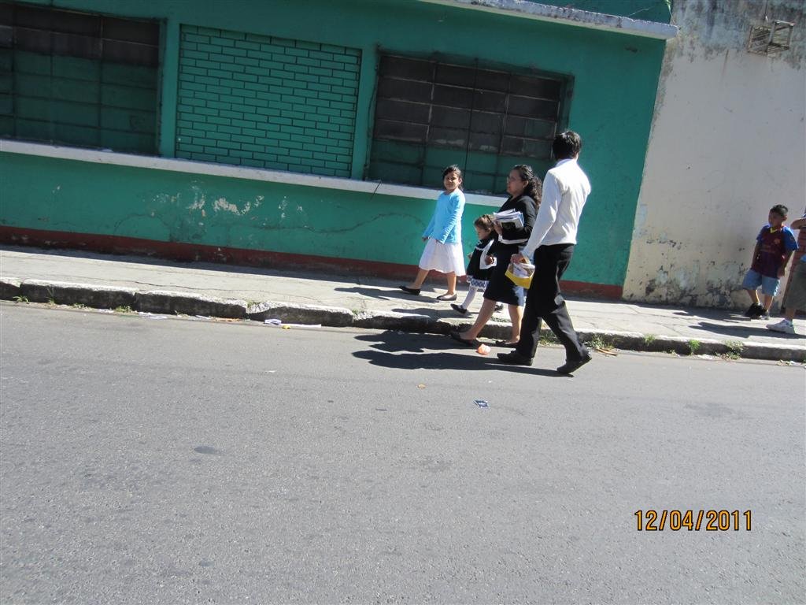

Slide 26
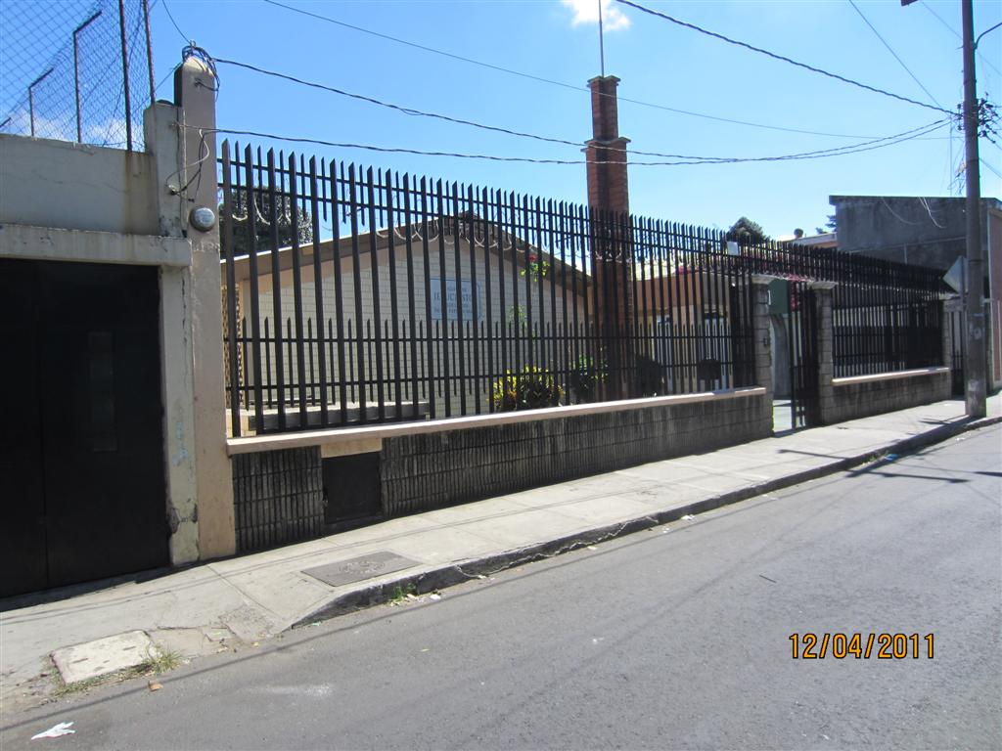

Slide 27
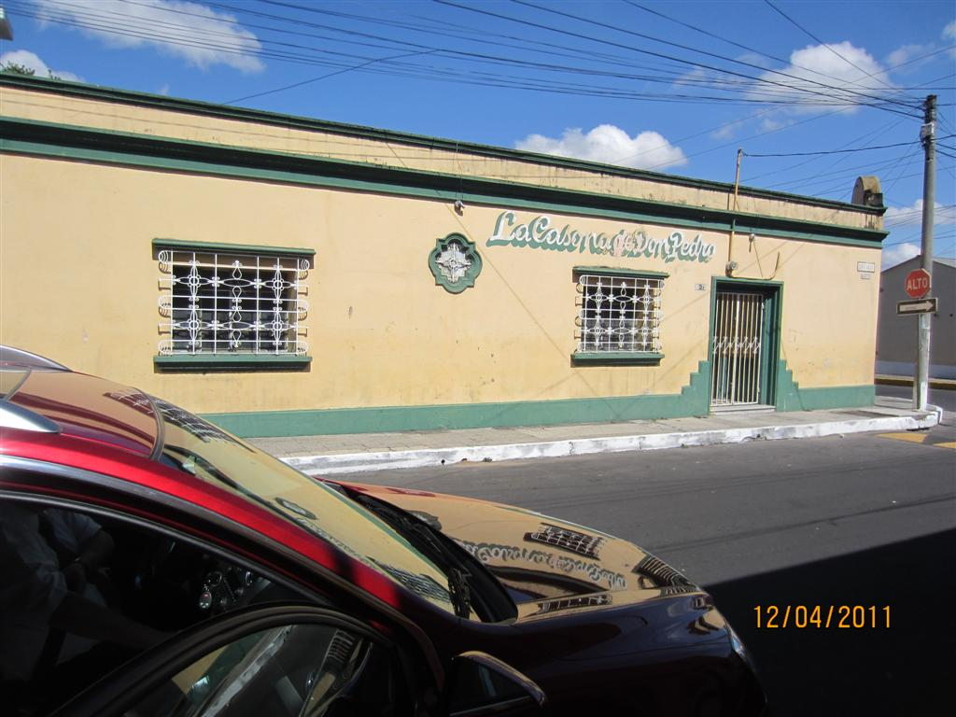

Slide 28
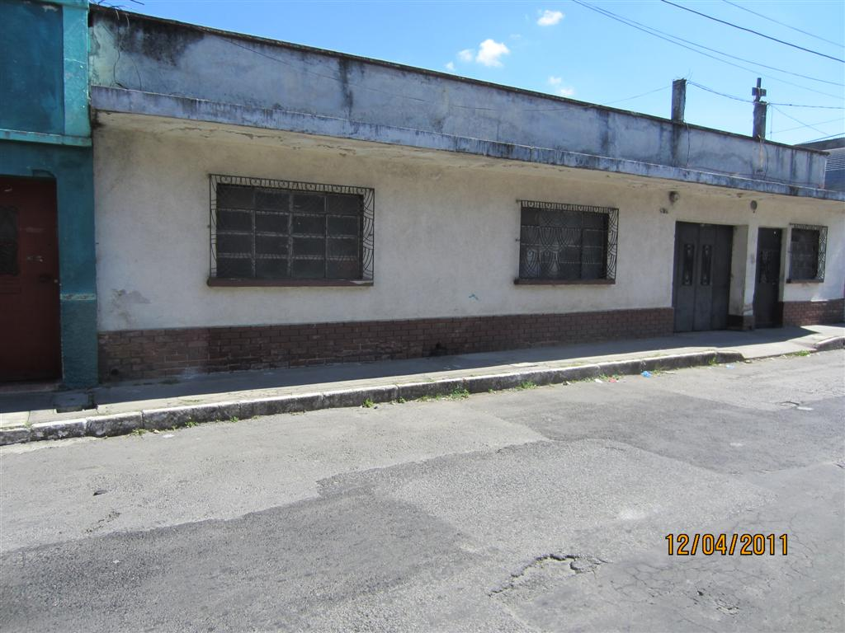

Slide 29
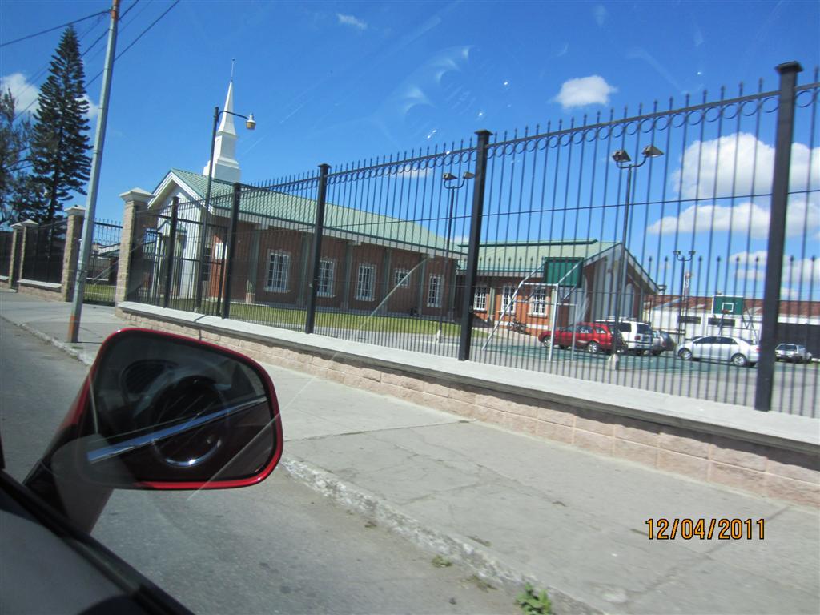

Slide 30
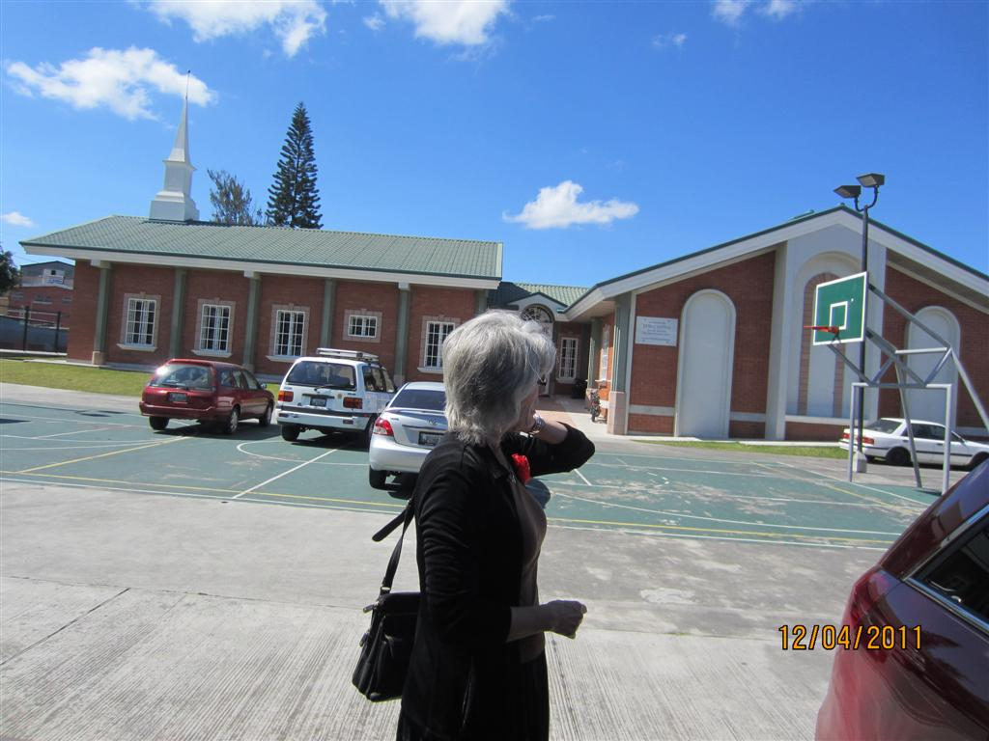

Slide 31
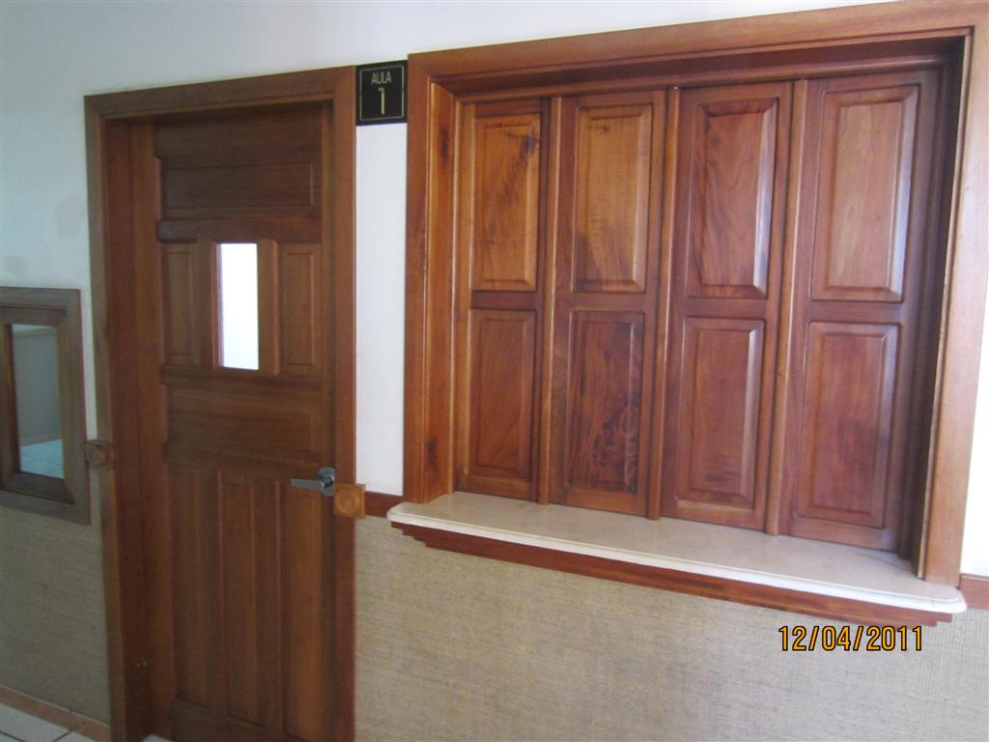

Slide 32
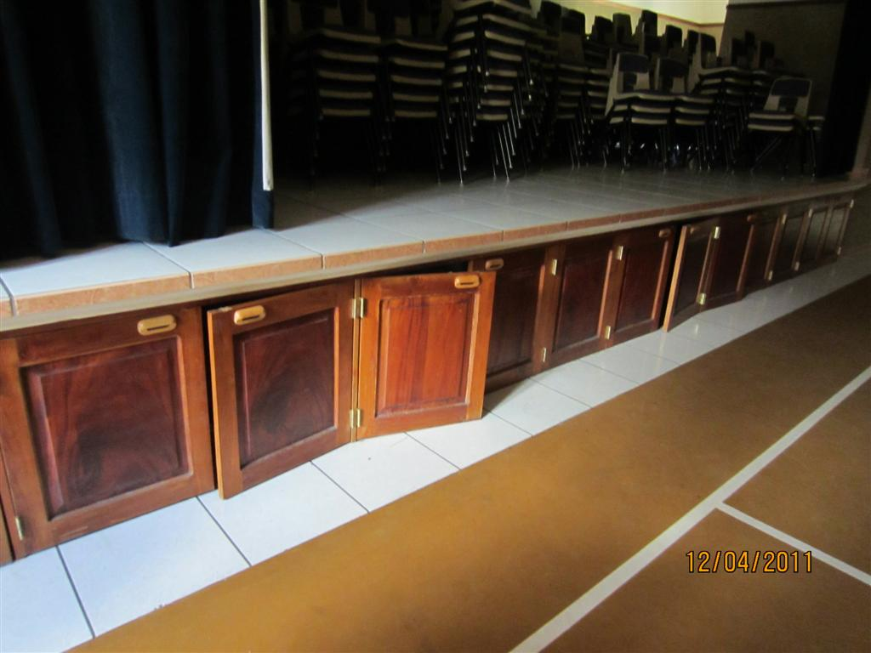

Slide 33
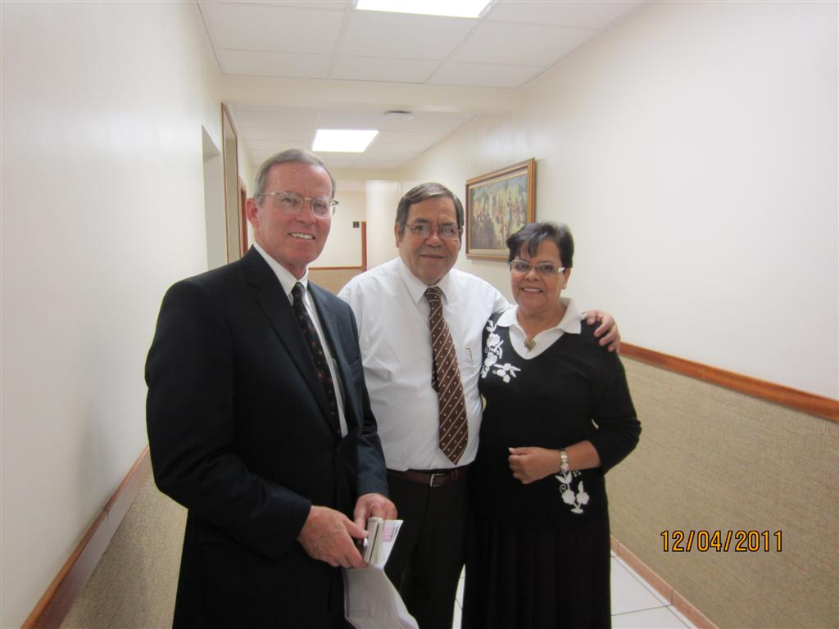

Slide 34
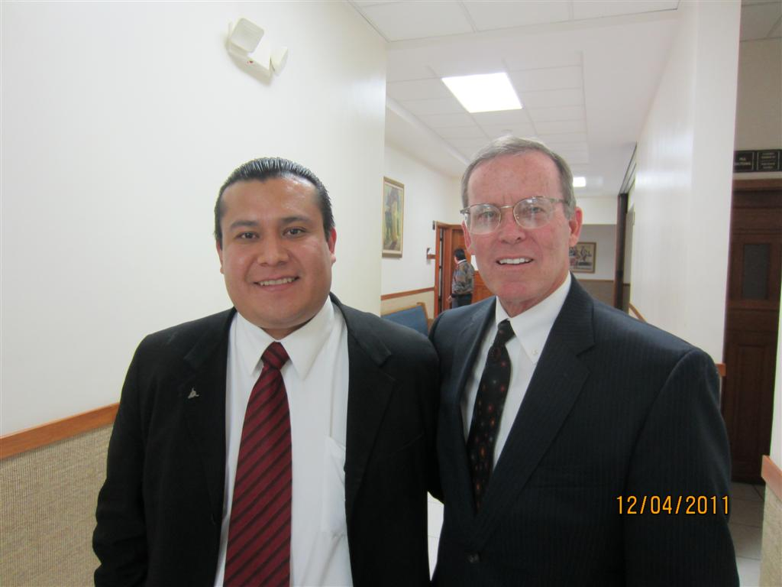

Slide 35
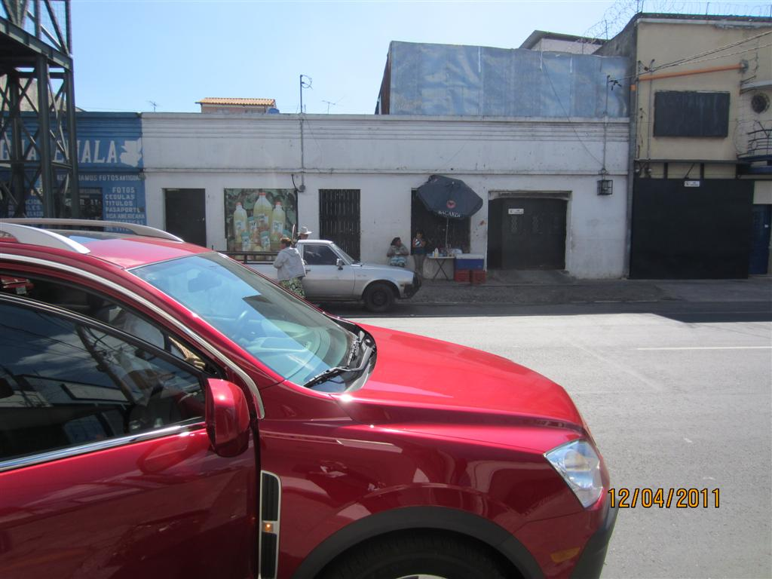

Slide 36
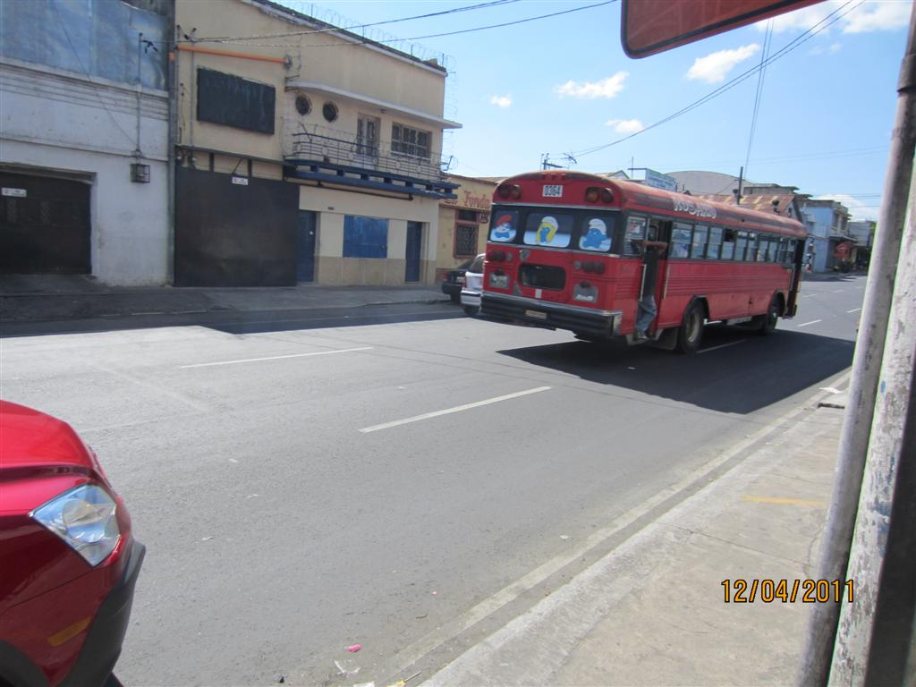

Slide 37
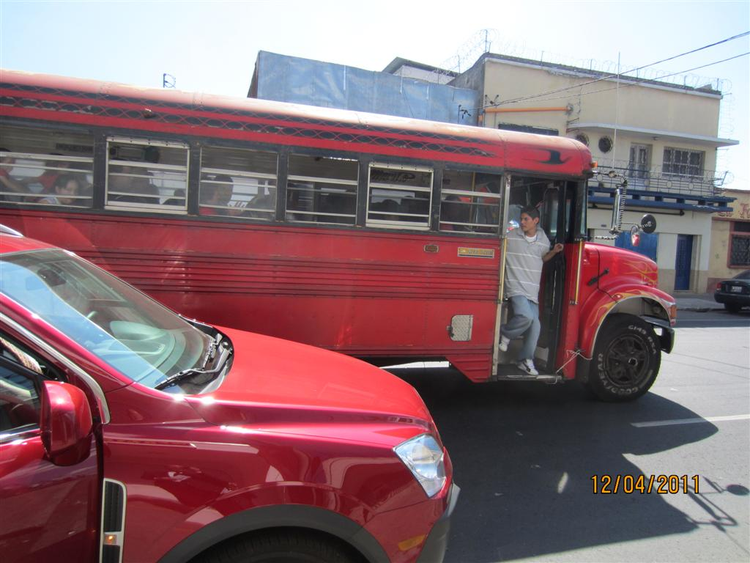

Slide 38
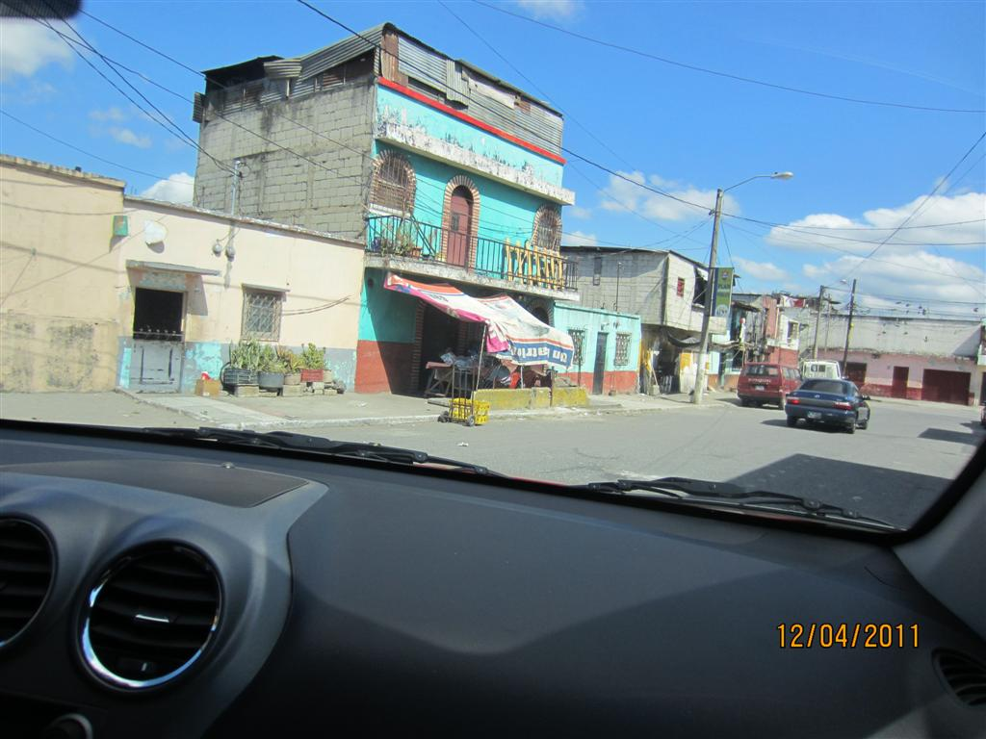

Slide 39
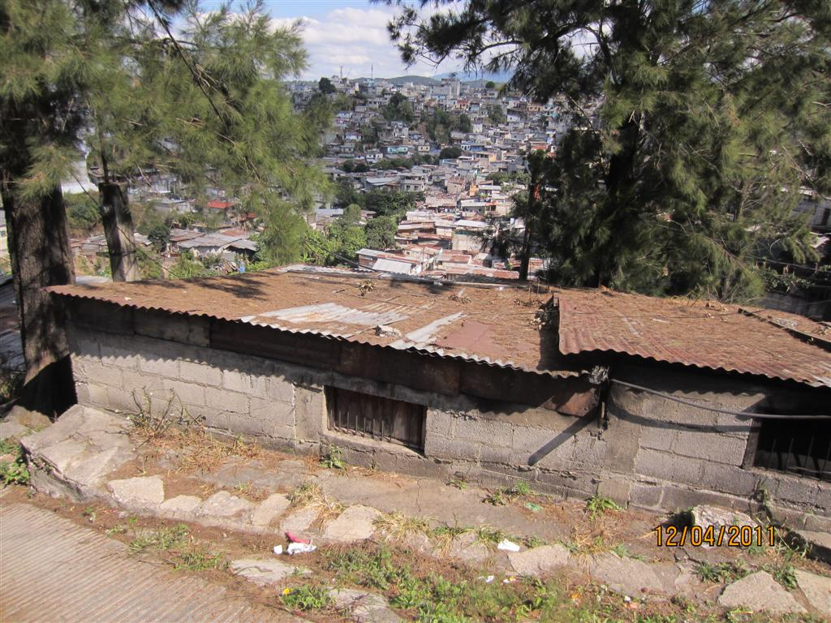

Slide 40
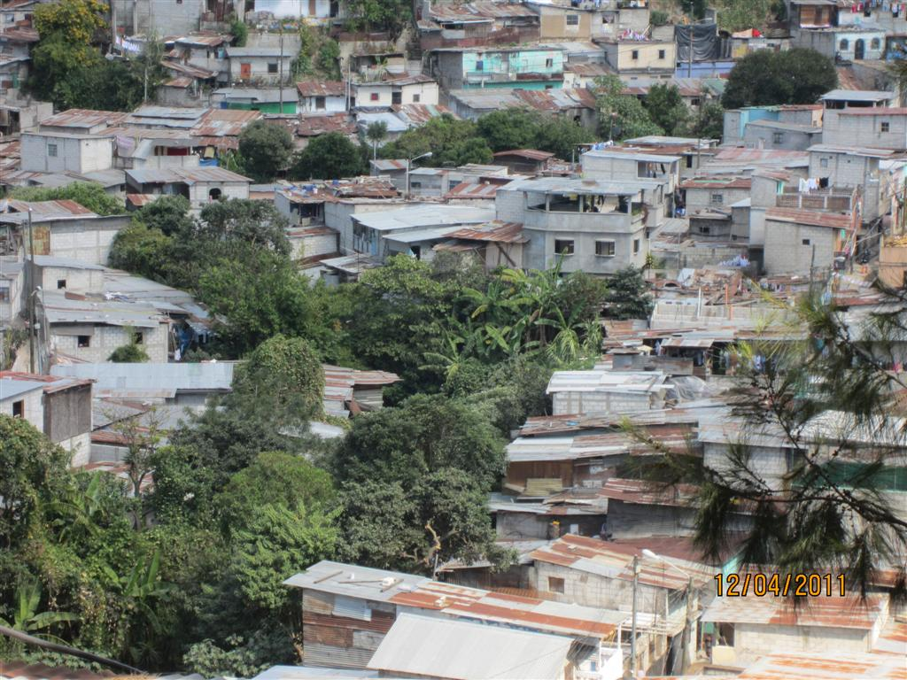

Slide 41
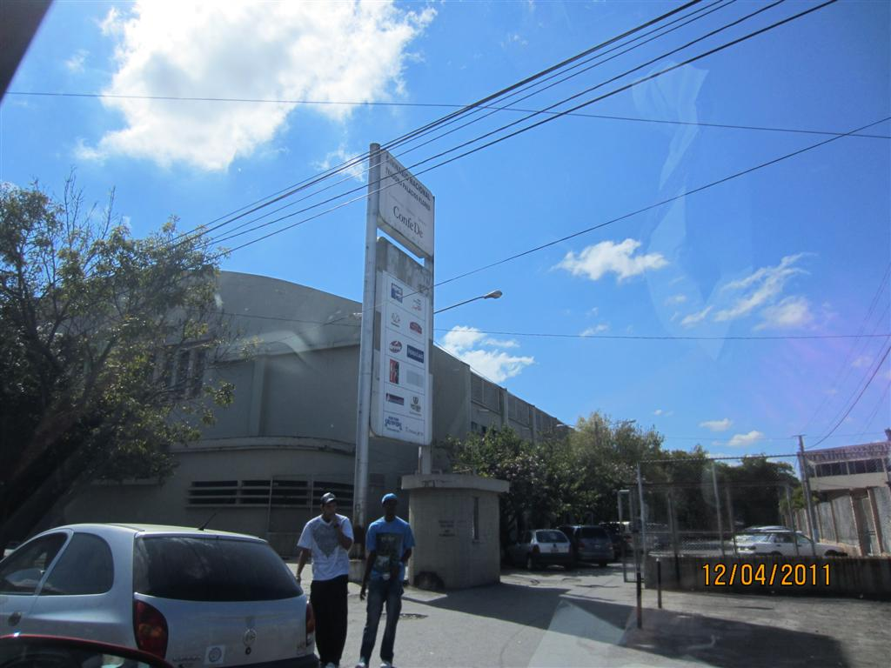

Slide 42
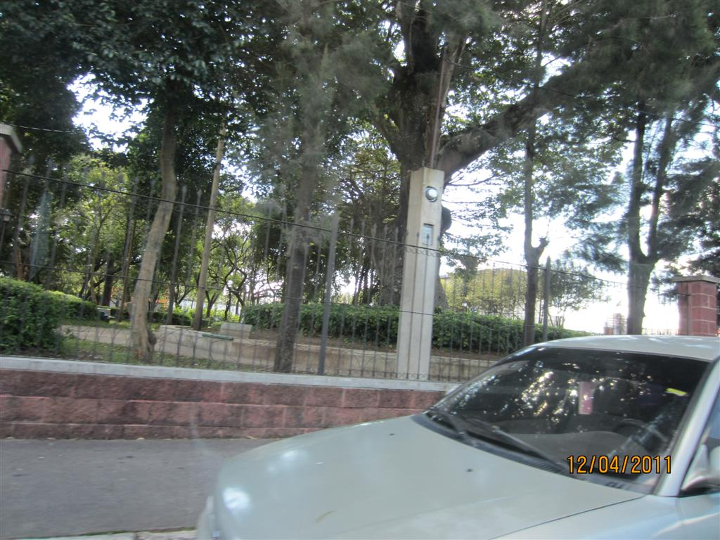

Slide 43
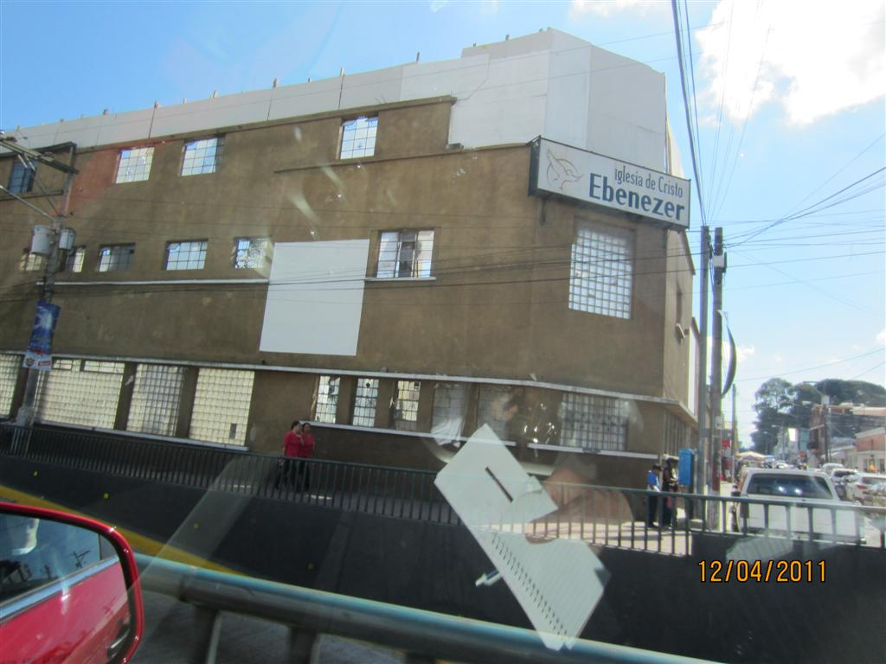

Slide 44
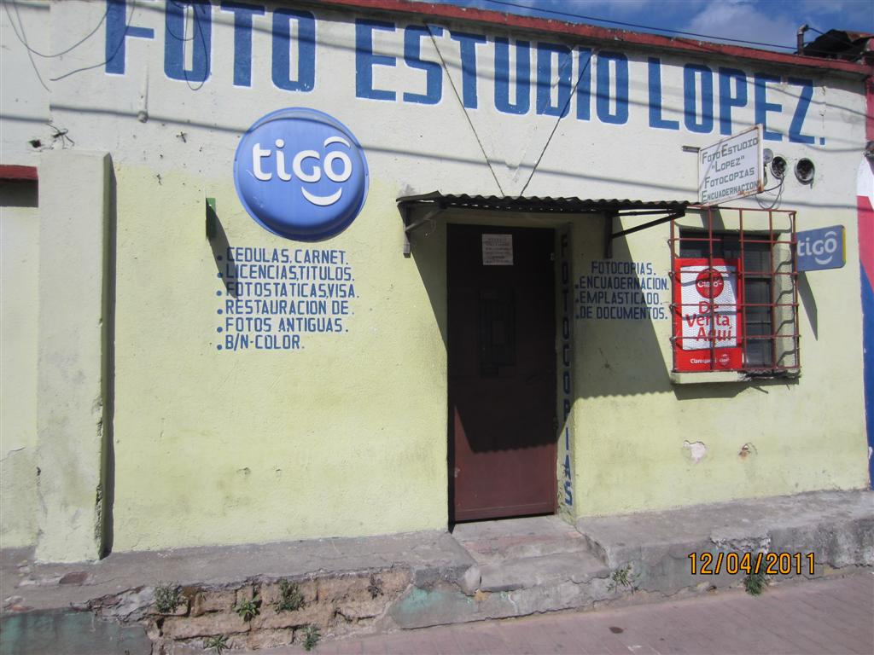

Slide 45
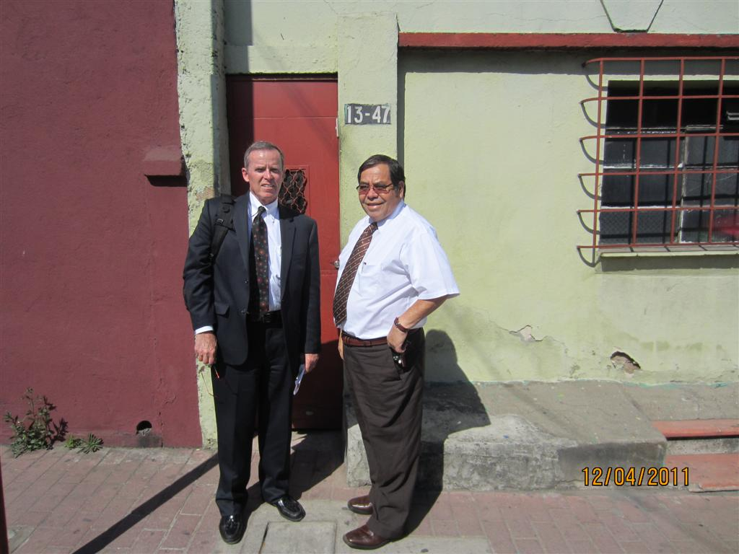

Slide 46
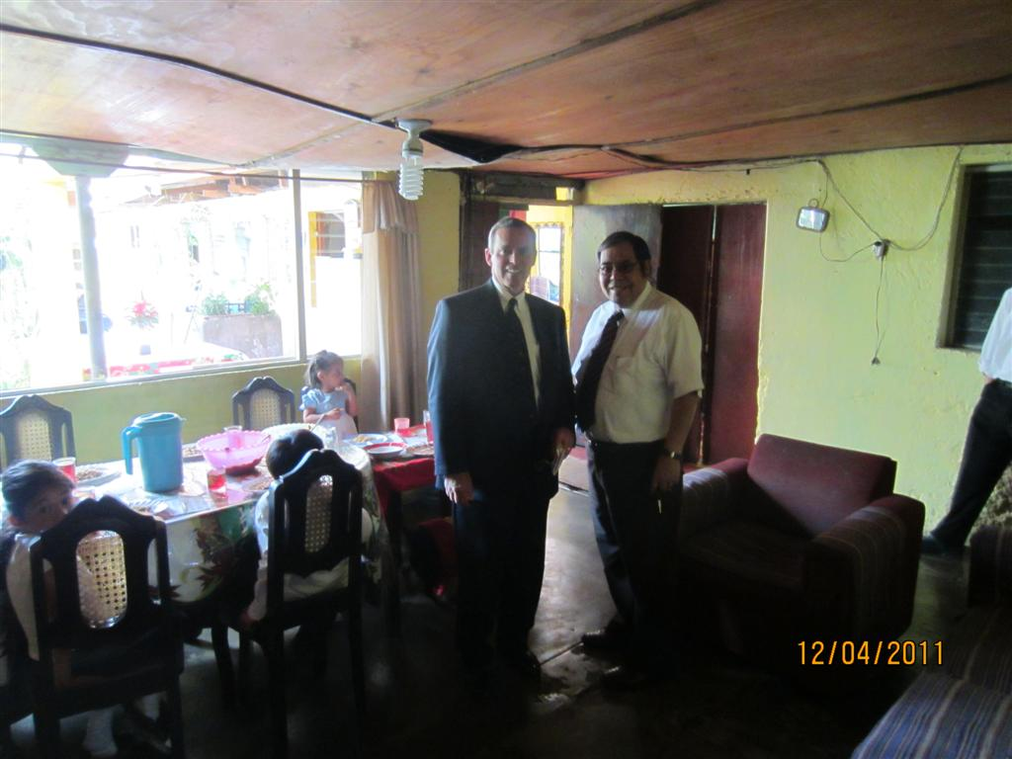

Slide 47
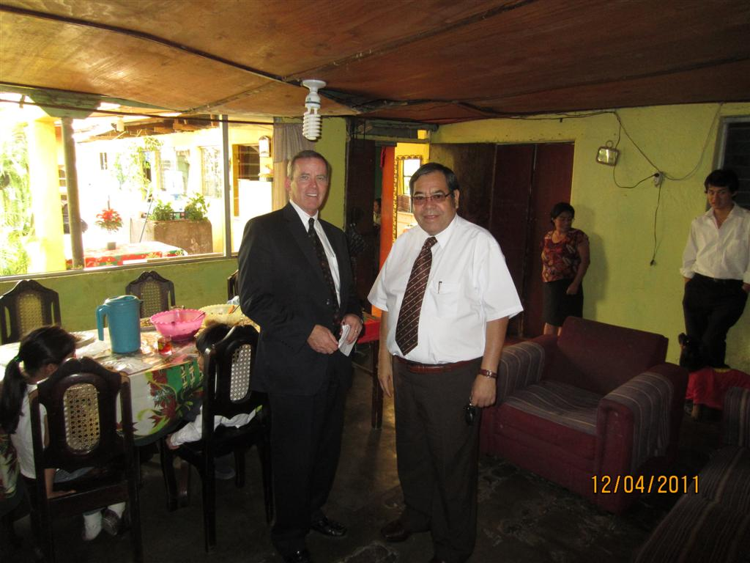

Slide 48
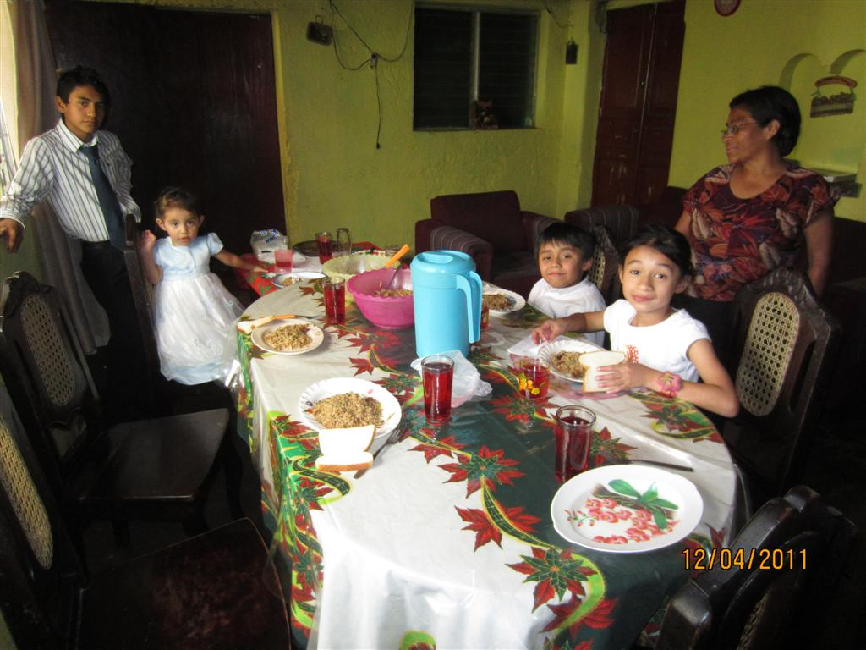

Slide 49
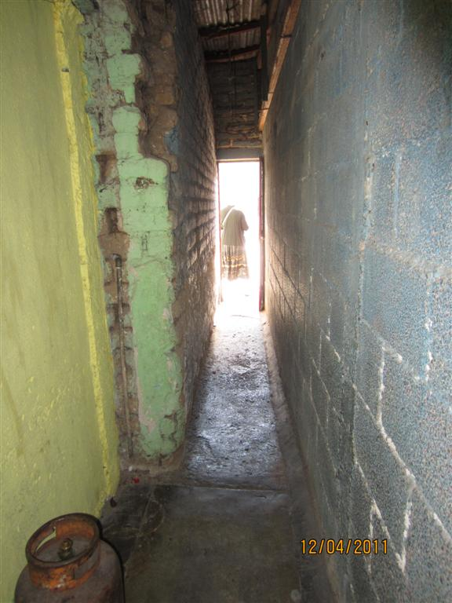

Slide 50
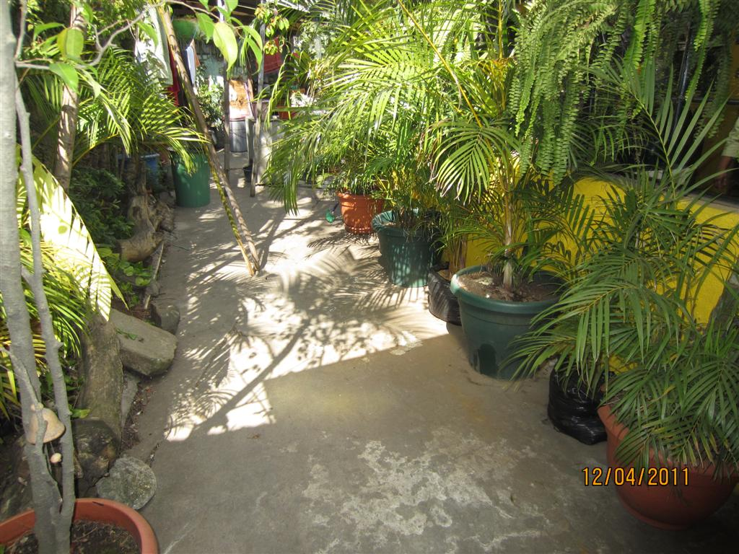

Slide 51
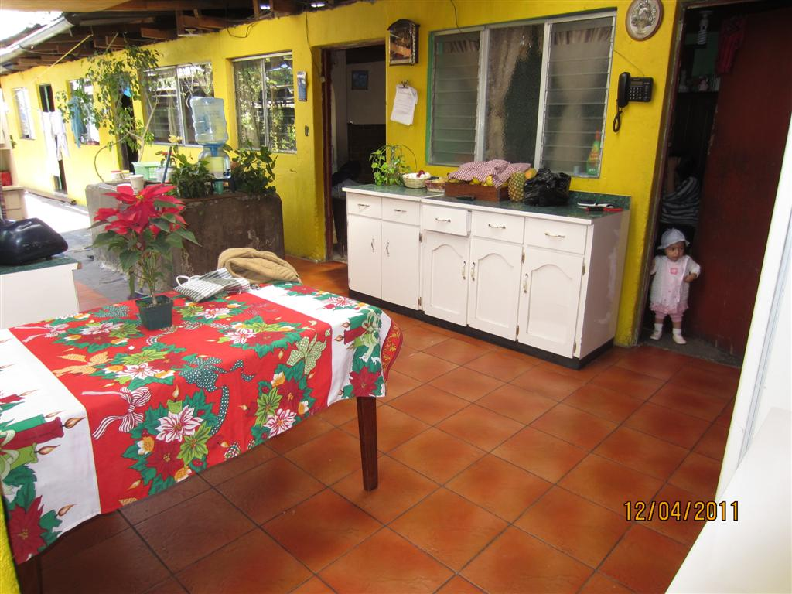

Slide 52
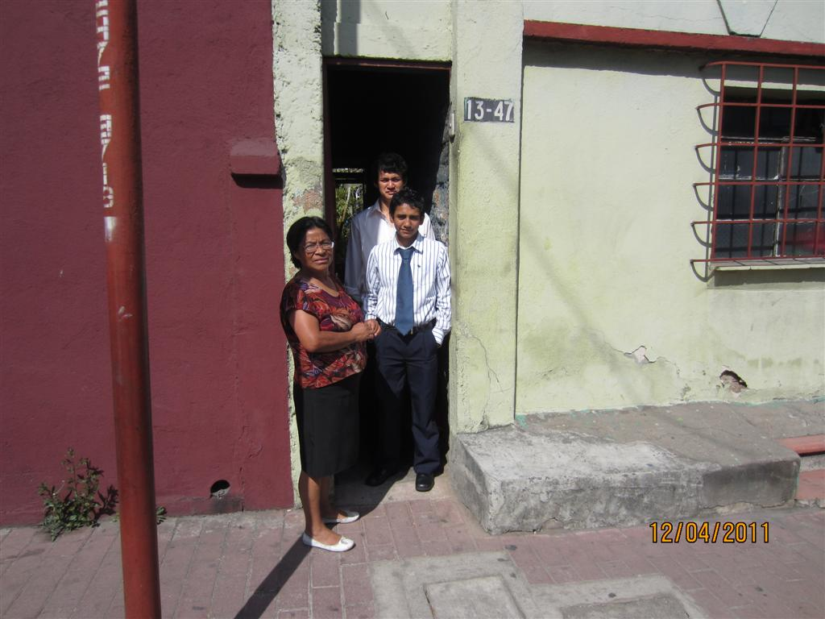

Slide 53


Slide 54


Slide 55


Slide 56


Slide 57


Slide 58


Slide 59


Slide 60


Slide 61


Slide 62


Slide 63


Slide 64


Slide 65


Slide 66


Slide 67


Slide 68


Slide 69


Slide 70


Slide 71


Slide 72


Slide 73


Slide 74


