Slide 1
Day 13 - Tuesday
December 13, 2011

Slide 2
Dropped off car at rental agency.
Met Sister Suzanne Limburg who was with the Southwicks/Perkins at dedication. Also met Flory Palaj Evans (David Evans who served as missionary 97-97??-they live in Sonora, CA)…she is from Reu.
Met Bro. and Sis. Lunt mission president in 96? (also a missionary in 1955)…Henry Lunt 1824/53/4 wives…Infield rep for church

Slide 3
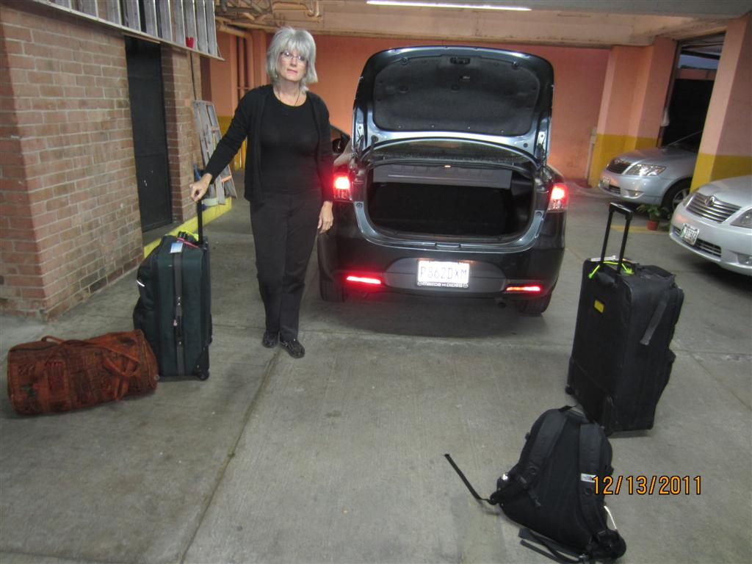

Slide 4
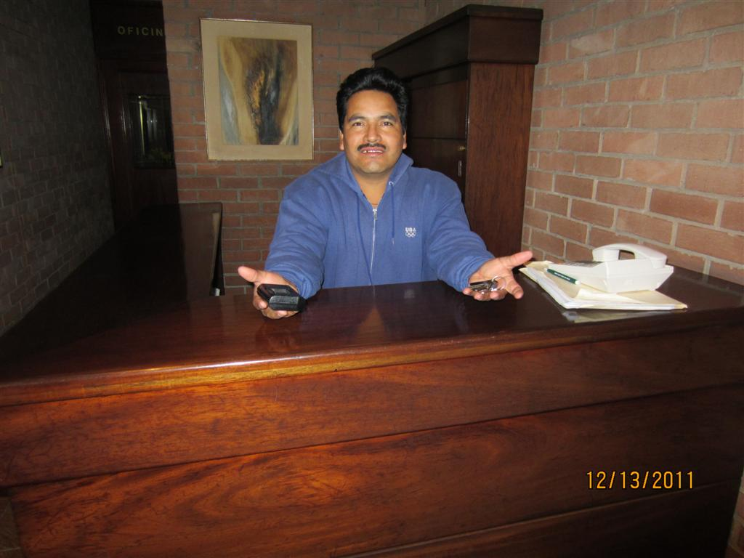

Slide 5
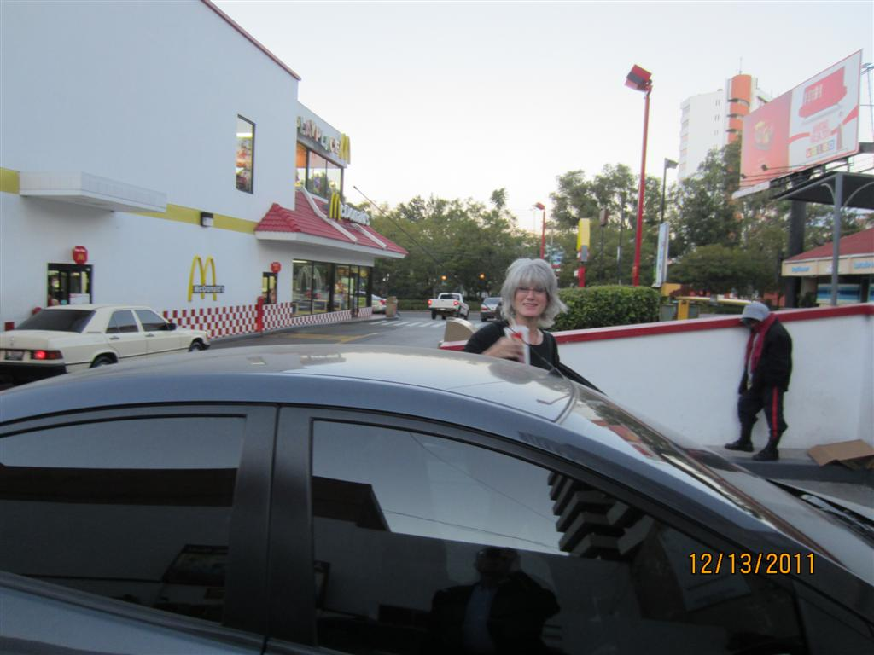

Slide 6
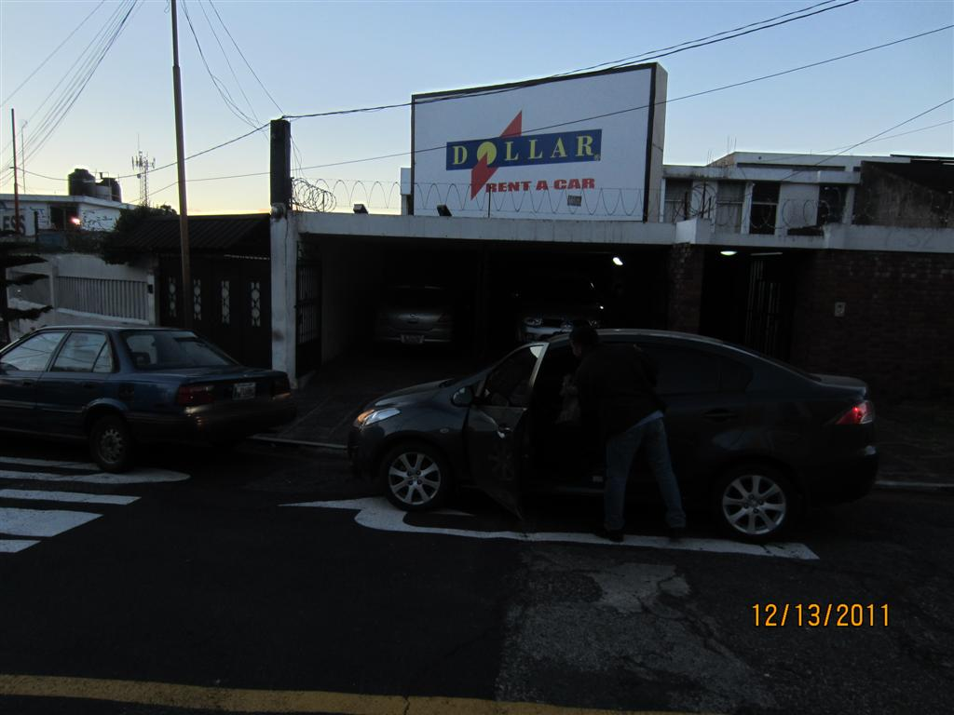

Slide 7
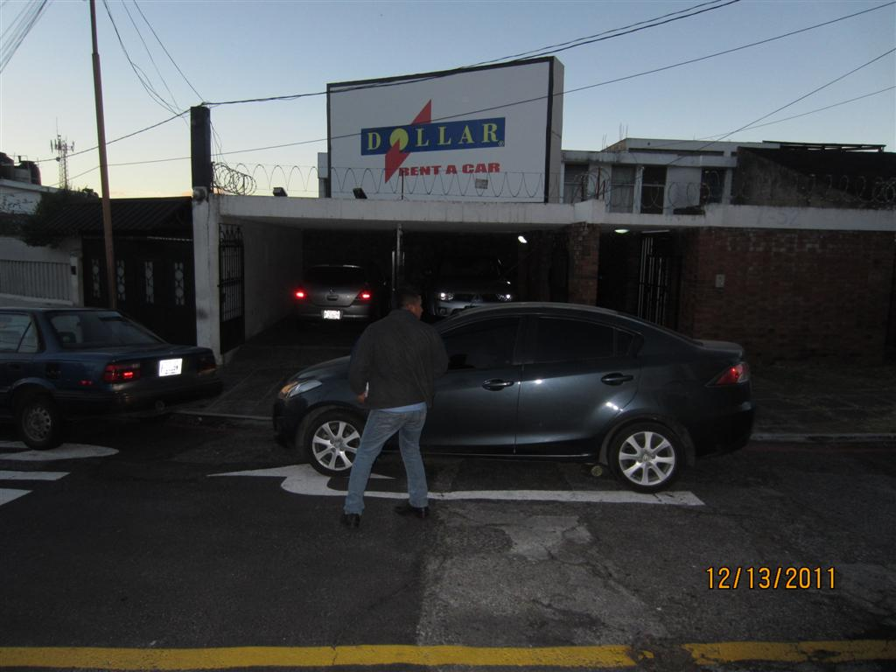

Slide 8
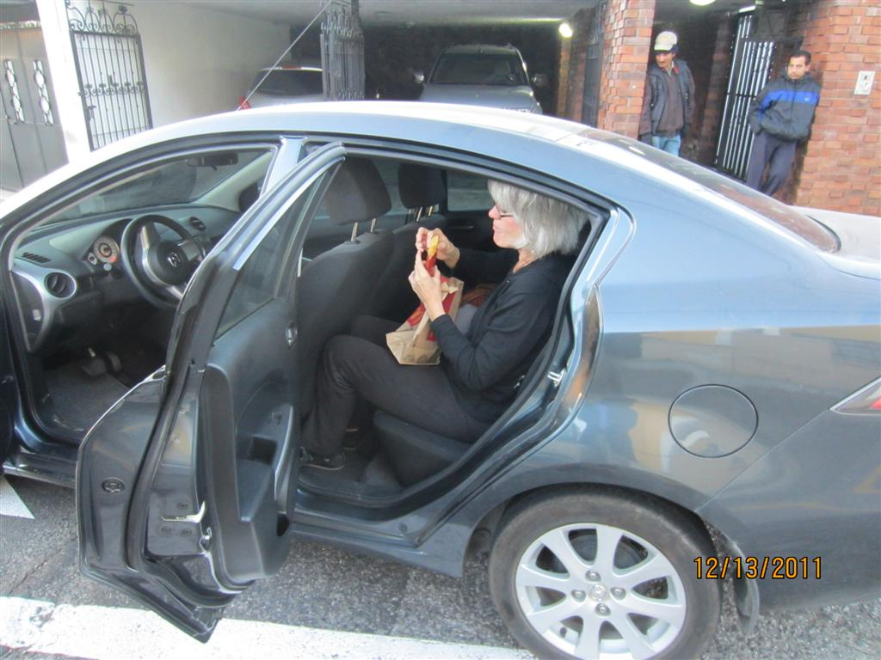

Slide 9
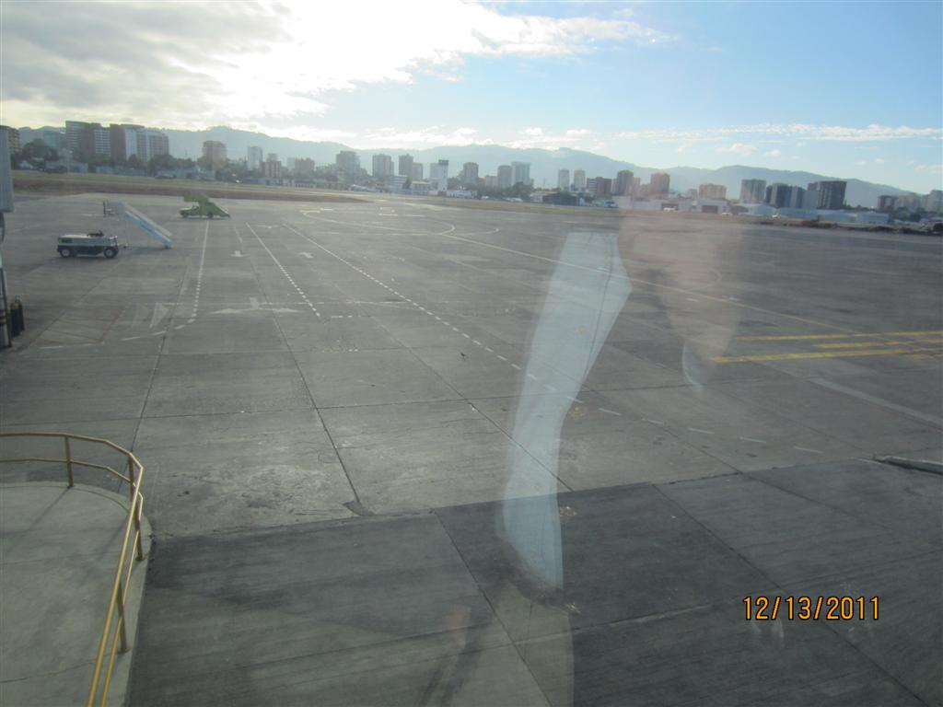

Slide 10
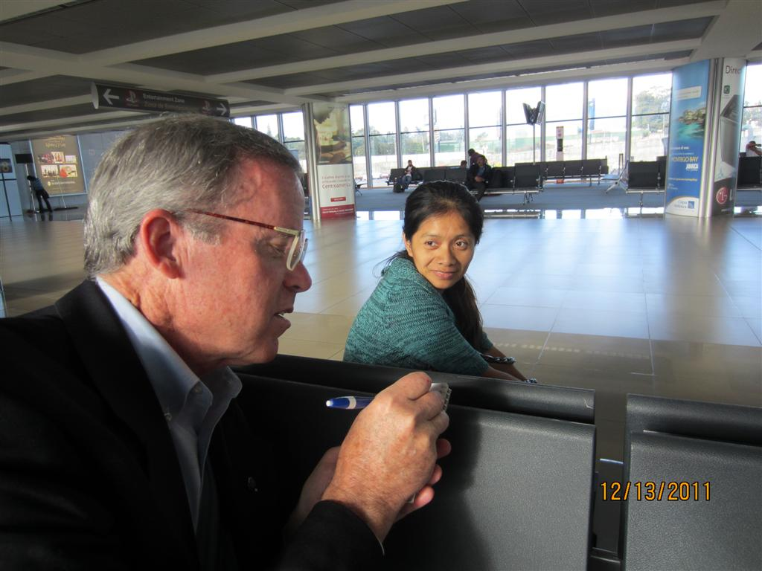

Slide 11
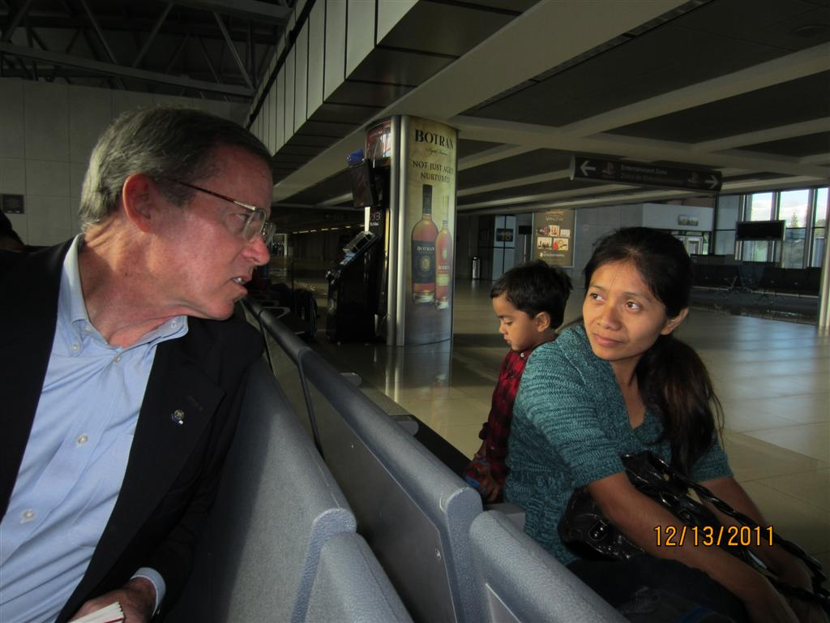

Slide 12
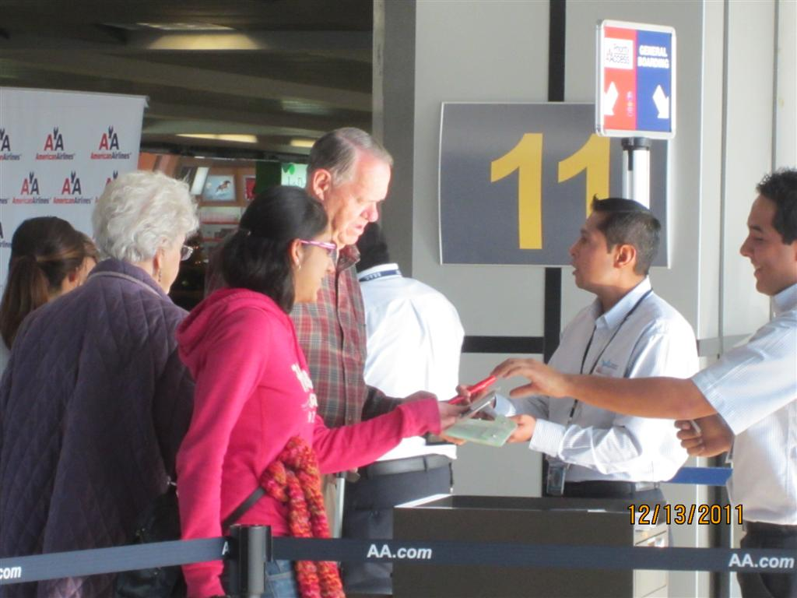

Slide 13
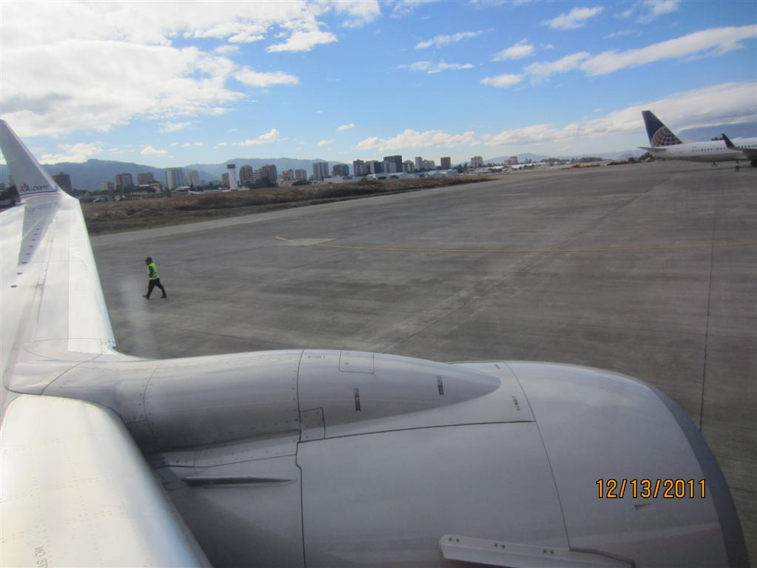

Slide 14
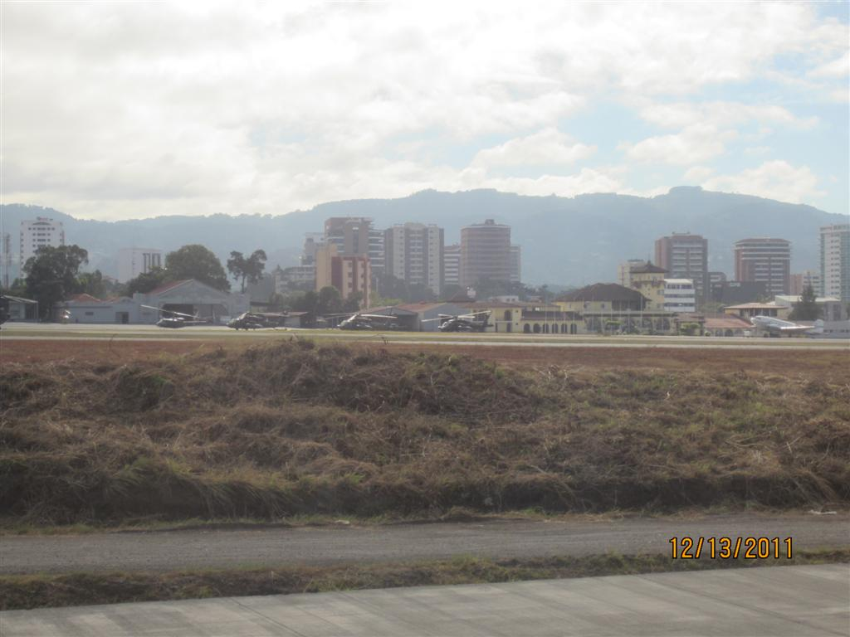

Slide 15
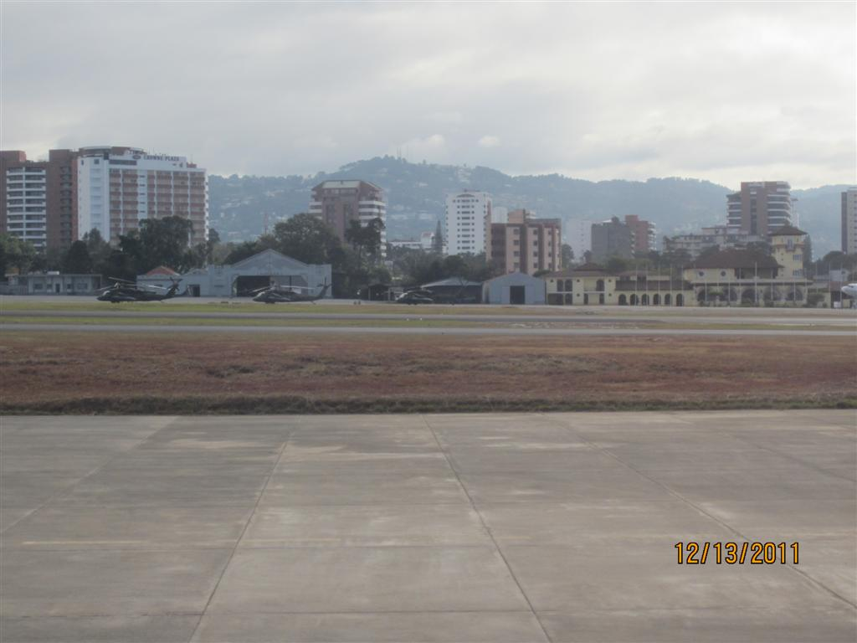

Slide 16
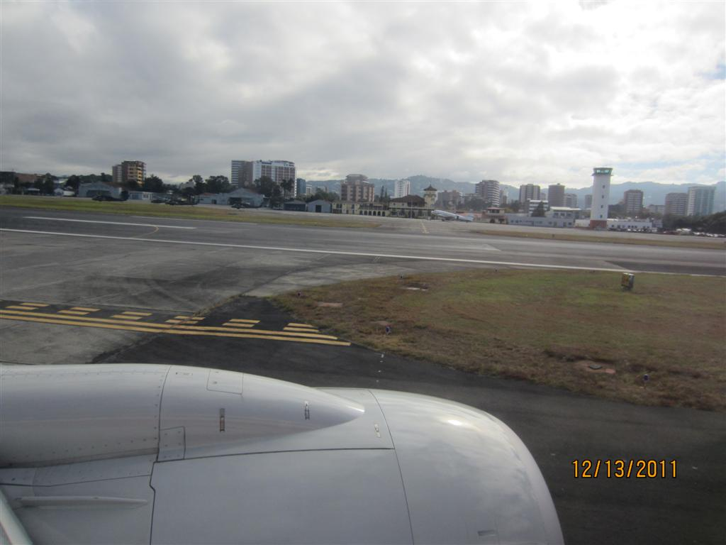

Slide 17
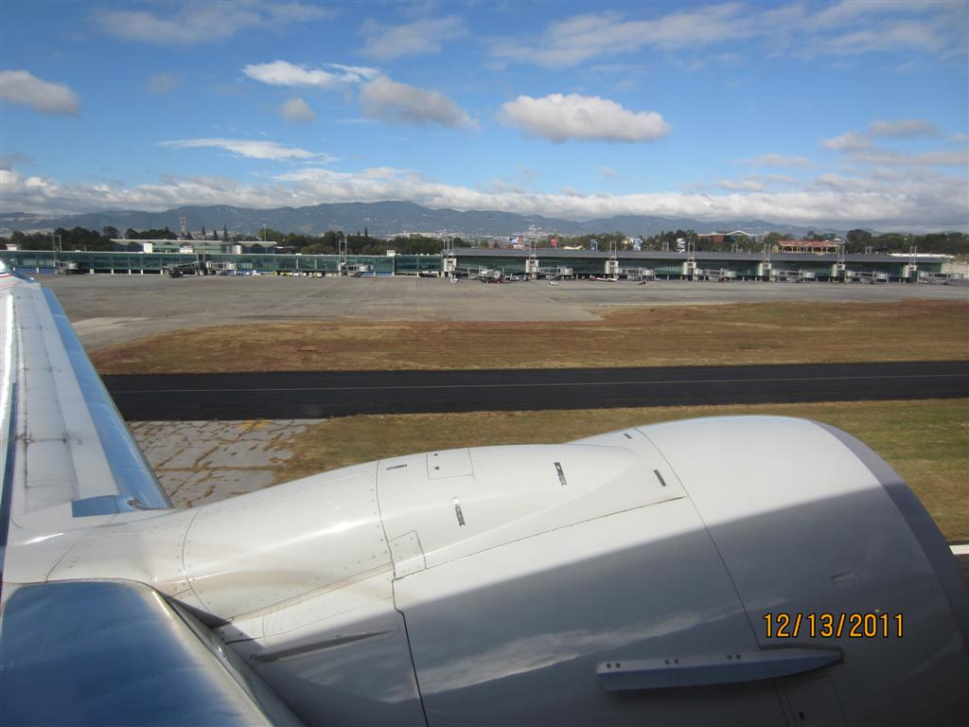

Slide 18
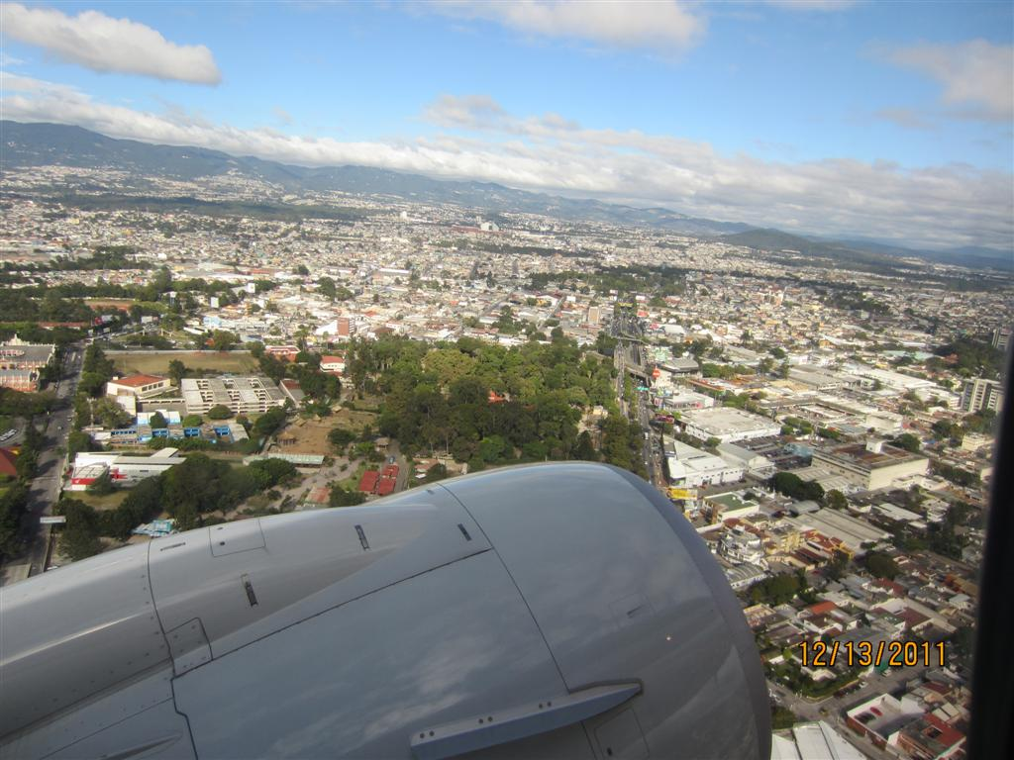

Slide 19
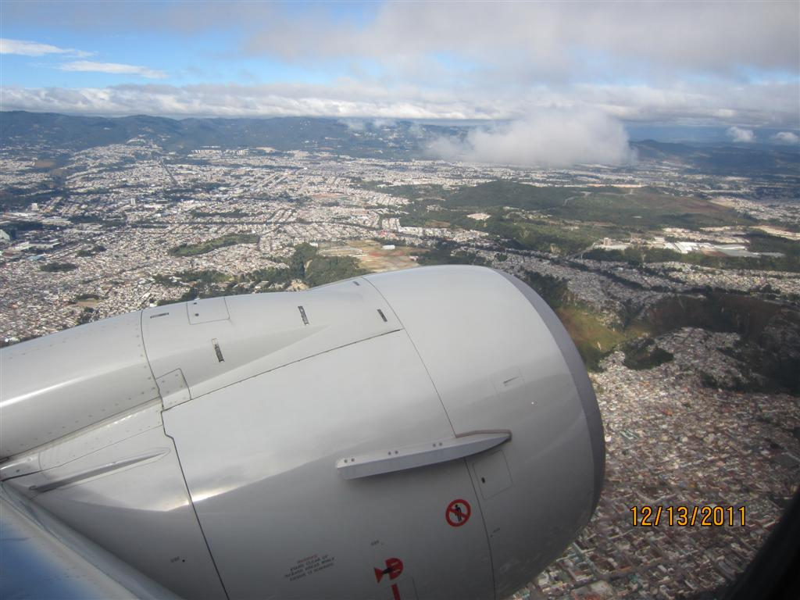

Slide 20
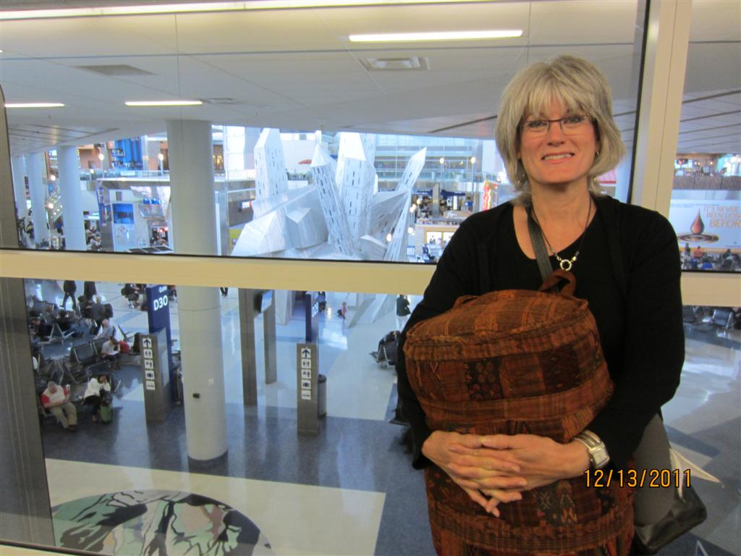

Slide 21
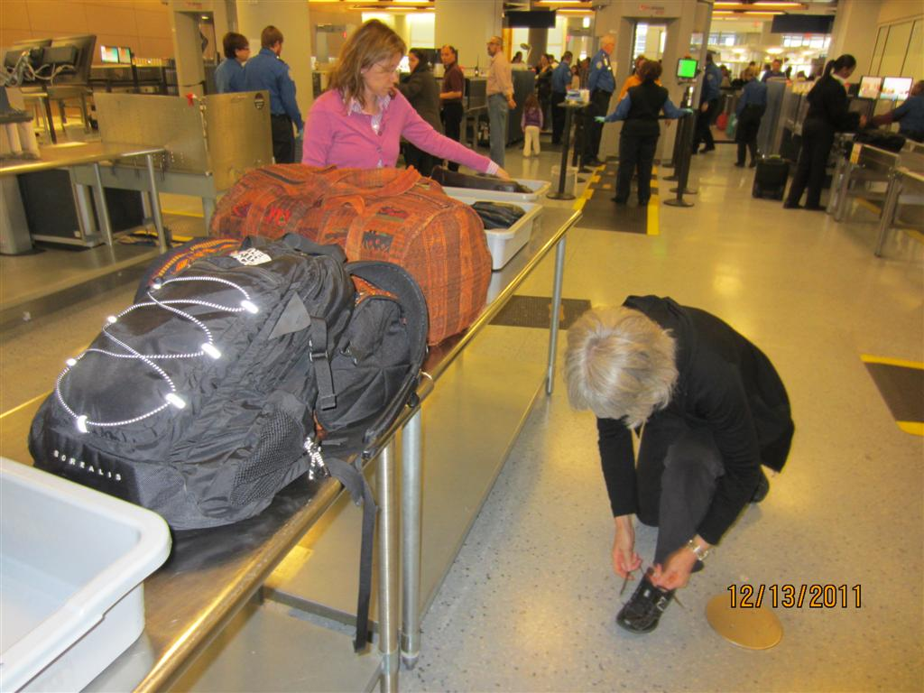

Slide 22
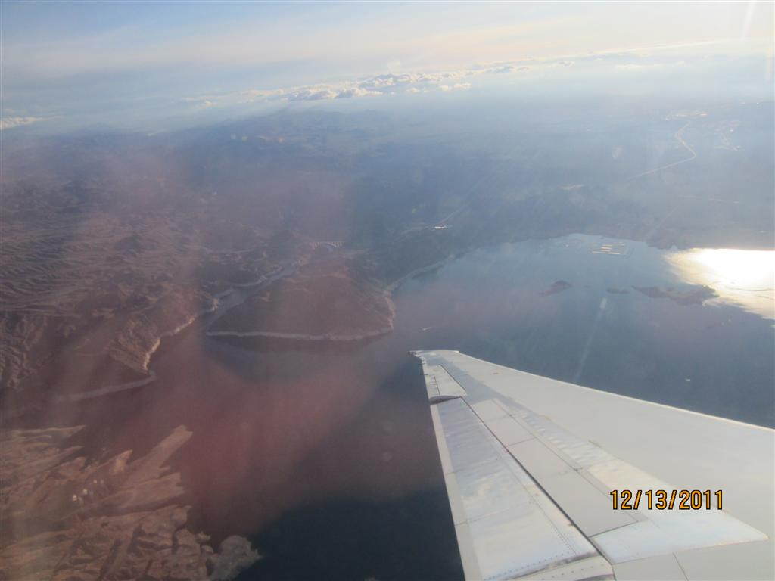

Slide 23
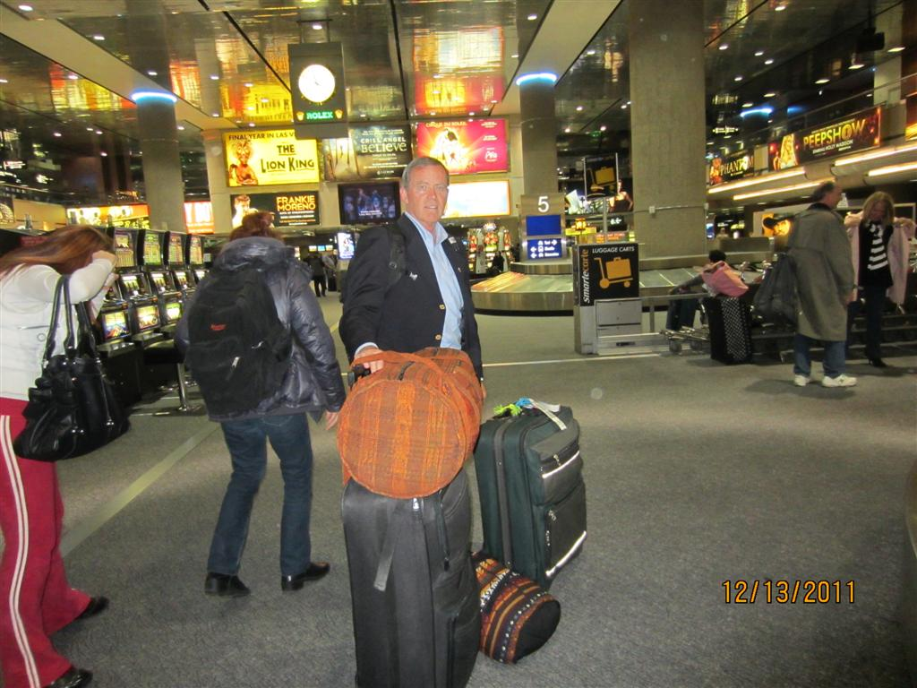

Slide 24
